Slide 1
Get Ready For Book War!!!
Explanation based on Evergreen MS – June 2013

Slide 2
Last year, 221 8th graders at Evergreen read books off a list of 24 books. . . .

Slide 3
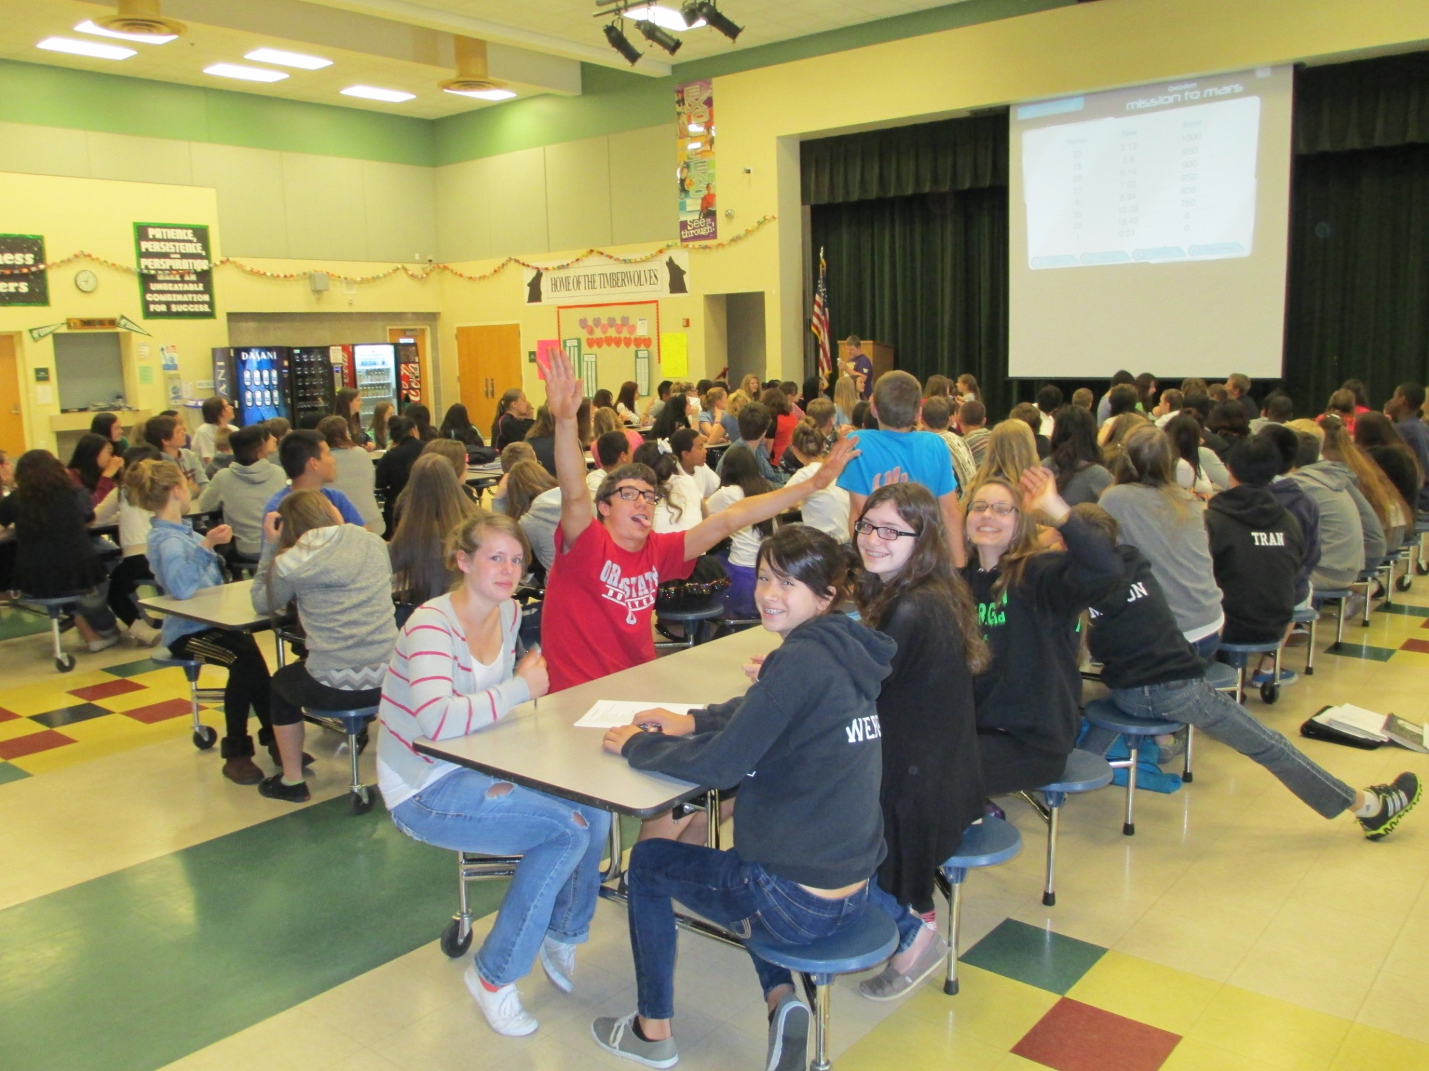

Slide 4
. . . . and then competed
in a final battle to determine
the ultimate book warriors
of the 8th grade.

Slide 5
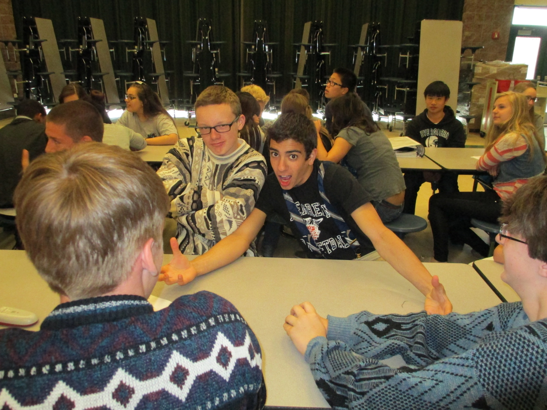

Slide 6
How does it work?

Slide 7
Questions flash on the screen, and each team has 30 seconds to figure out which book title is the answer…

Slide 8
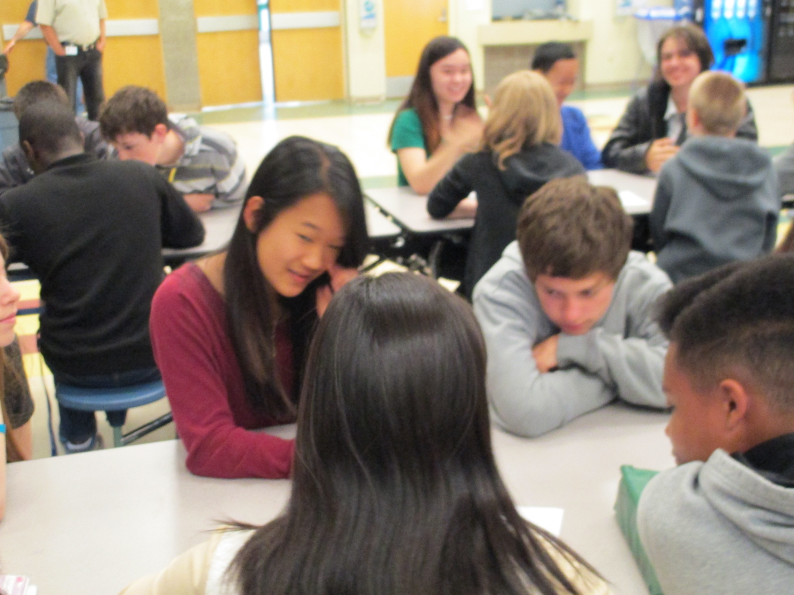

Slide 9
Teams get points for right answers in addition to extra points based on the speed with which they answer each question.

Slide 10
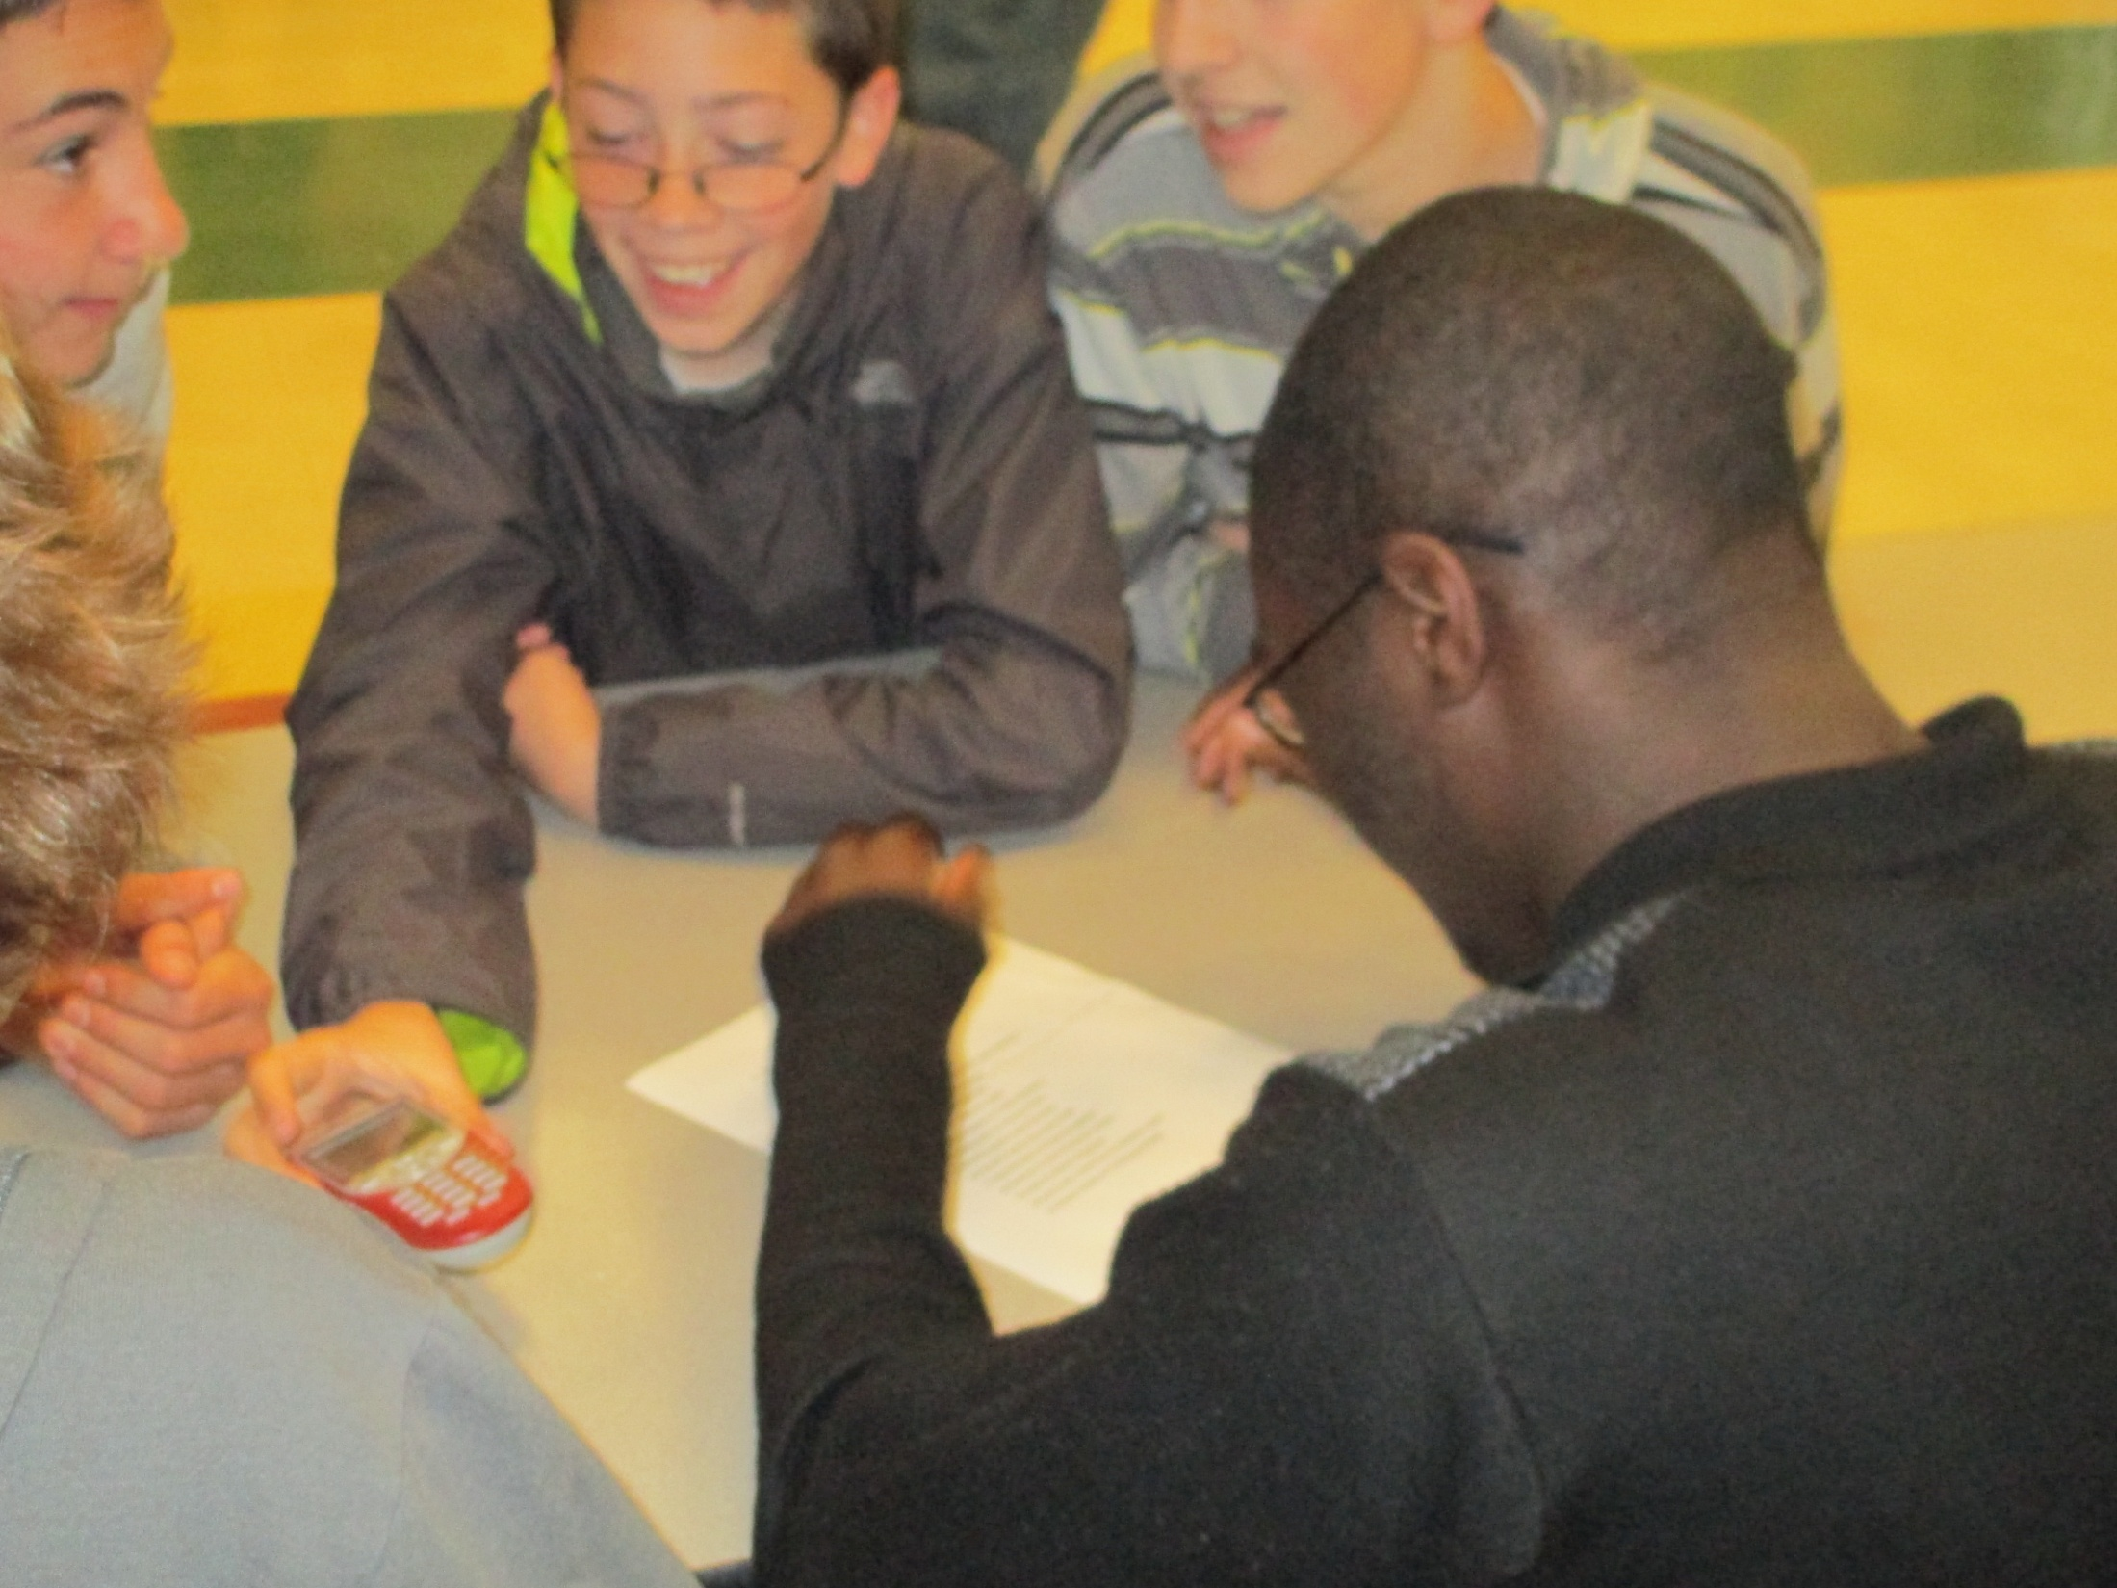

Slide 11
And then we DANCE!

Slide 12
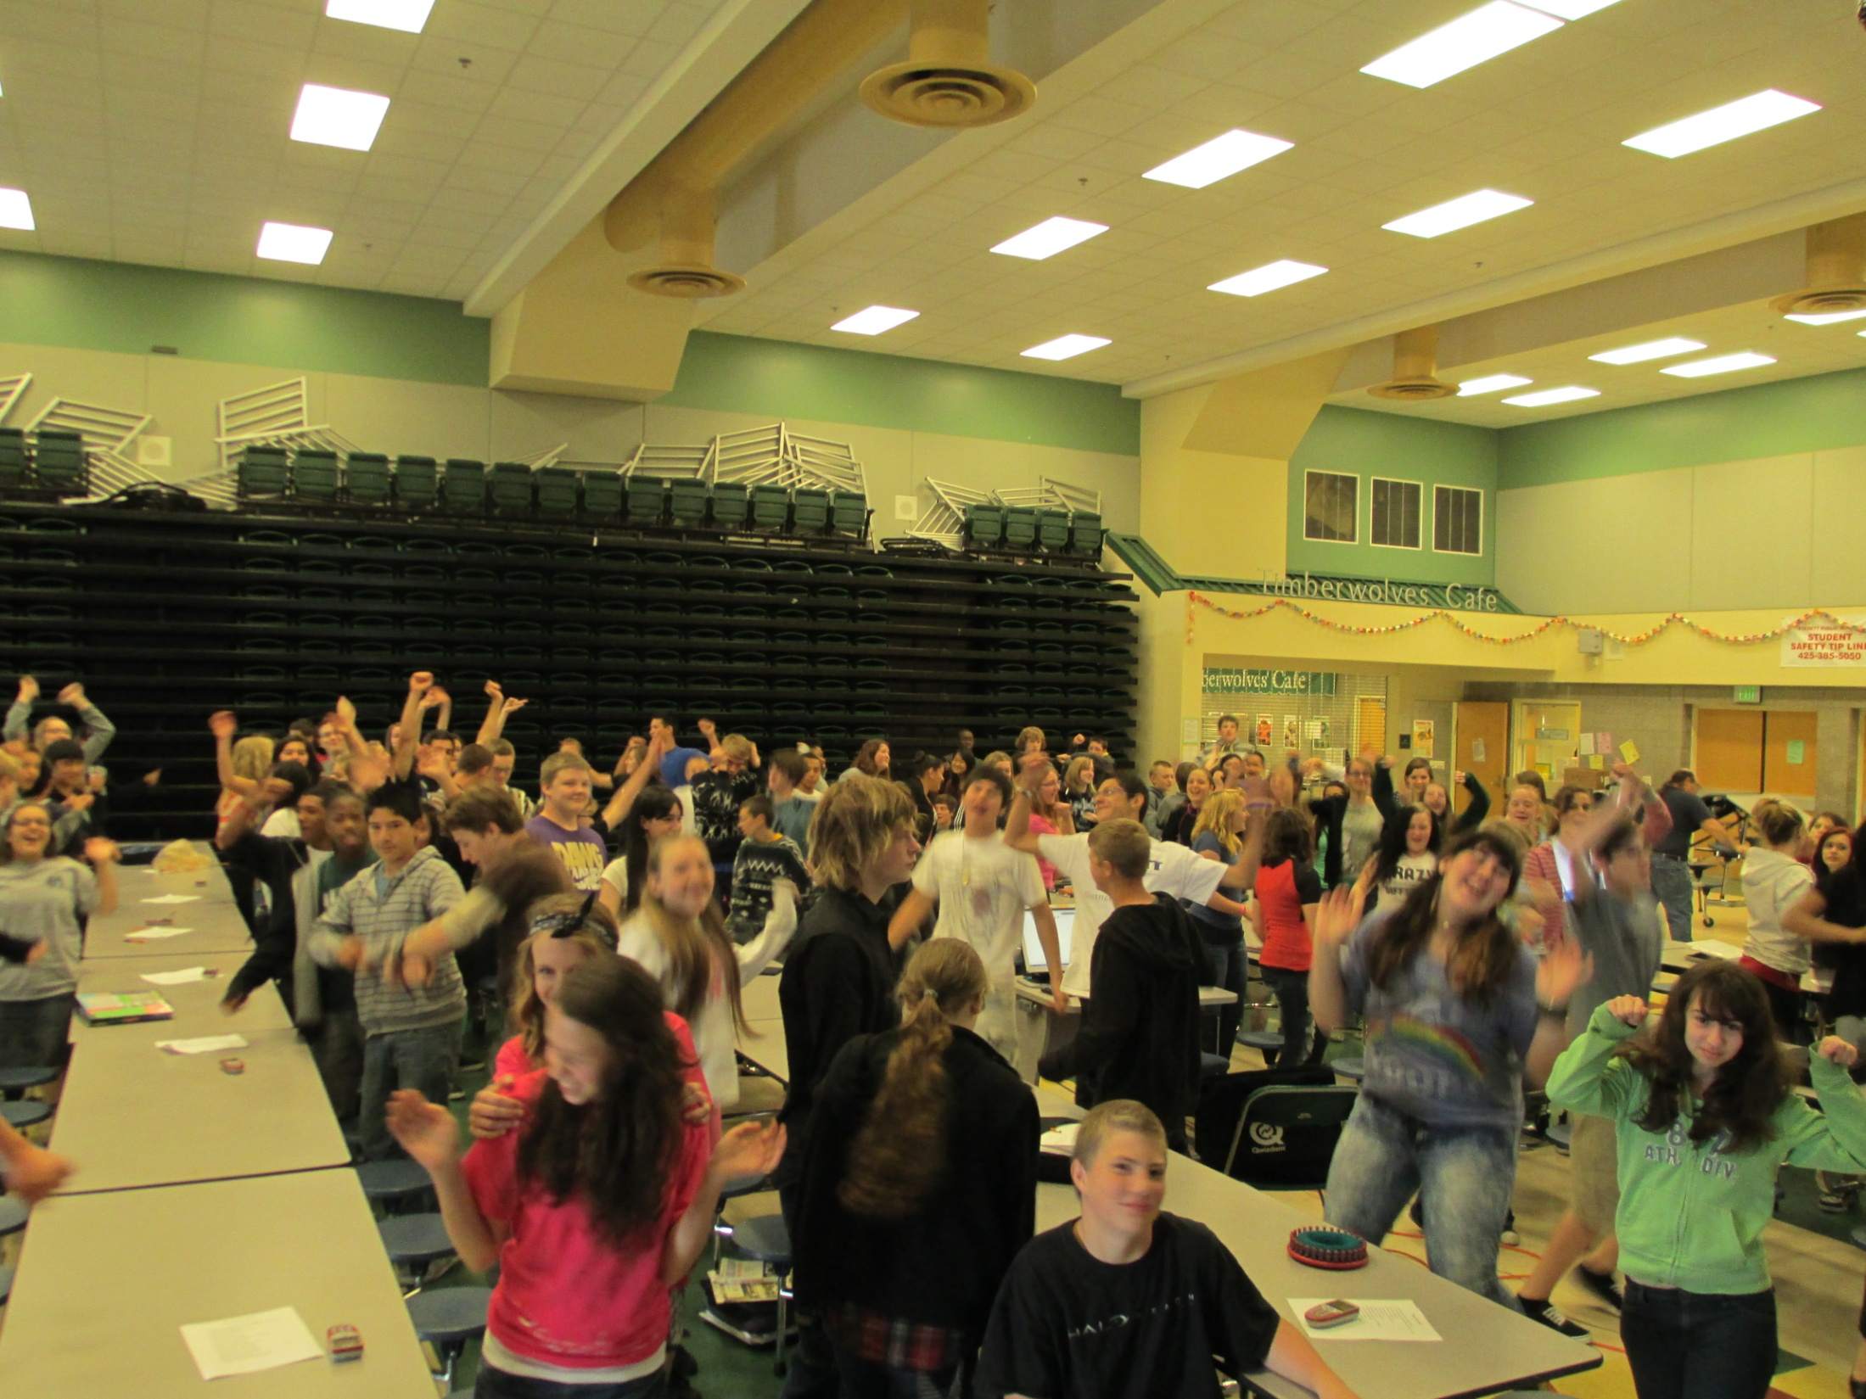

Slide 13
Here are this year’s books, so you can get your team ready!

Slide 14
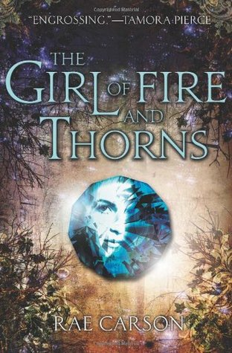
The Girl of Fire and Thorns by Rae Carson

Slide 15
Once a century, one person is chosen for greatness.
Elisa is the chosen one. But she is also the younger of two princesses. The one who has never done anything remarkable, and can't see how she ever will.
Now, on her sixteenth birthday, she has become the secret wife of a handsome and worldly king--a king whose country is in turmoil. A king who needs her to be the chosen one, not a failure of a princess.
And he's not the only one who seeks her. Savage enemies, seething with dark magic, are hunting her. A daring, determined revolutionary thinks she could be his people's savior, and he looks at her in a way that no man has ever looked at her before. Soon it is not just her life, but her very heart that is at stake.
Elisa could be everything to those who need her most. If the prophecy is fulfilled. If she finds the power deep within herself. If she doesn't die young. Most of the chosen do.

Slide 16

The Maze Runner by James Dashner

Slide 17
When Thomas wakes up in the lift, the only thing he can remember is his first name. His memory is blank. But he’s not alone. When the lift’s doors open, Thomas finds himself surrounded by kids who welcome him to the Glade—a large, open expanse surrounded by stone walls.
Just like Thomas, the Gladers don’t know why or how they got to the Glade. All they know is that every morning the stone doors to the maze that surrounds them have opened. Every night they’ve closed tight. And every thirty days a new boy has been delivered in the lift.
Thomas was expected. But the next day, a girl is sent up—the first girl to ever arrive in the Glade. And more surprising yet is the message she delivers.
Thomas might be more important than he could ever guess. If only he could unlock the dark secrets buried within his mind.

Slide 18

What Happened to Goodbye by Sarah Dessen

Slide 19
Since her parents' bitter divorce, Mclean and her dad, a restaurant consultant, have been on the move - four towns in two years. Estranged from her mother and her mother's new family, Mclean has followed her dad in leaving the unhappy past behind. And each new place gives her a chance to try out a new persona: from cheerleader to drama diva.
But now, for the first time, Mclean discovers a desire to stay in one place and just be herself - whoever that is. Perhaps her neighbor Dave, an academic superstar trying to be just a regular guy, can help her find out.
Combining Sarah Dessen's trademark graceful writing, great characters, and compelling storytelling, What Happened to Goodbye is irresistible reading.

Slide 20

Michael Vey: The Prisoner of cell 25
by Richard Evans

Slide 21
To everyone at Meridian High School, fourteen-year-old Michael Vey is nothing special, just the kid who has Tourette’s syndrome. But in truth, Michael is extremely special—he has electric powers. Michael thinks he is unique until he discovers that a cheerleader named Taylor has the same mysterious powers. With the help of Michael’s friend, Ostin, the three of them set out to discover how Michael and Taylor ended up with their abilities, and their investigation soon brings them to the attention of a powerful group who wants to control the electric teens—and through them, the world.
#1 New York Times bestselling author Richard Paul Evans introduces a character whose risk-filled exploration marks the beginning of a riveting new series. With only his powers, his wits, and his friends to protect him, Michael will need all his strength to survive….

Slide 22
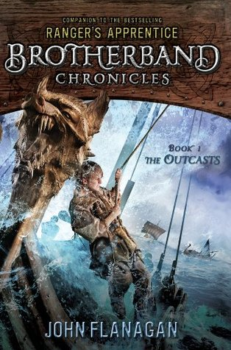
The Outcasts by John Flanagan

Slide 23
From the author of the global phenomenon Ranger's Apprentice!
They are outcasts. Hal, Stig, and the others - they are the boys the others want no part of. Skandians, as any reader of Ranger's Apprentice could tell you, are known for their size and strength. Not these boys. Yet that doesn't mean they don't have skills. And courage - which they will need every ounce of to do battle at sea against the other bands, the Wolves and the Sharks, in the ultimate race. The icy waters make for a treacherous playing field . . . especially when not everyone thinks of it as playing. John Flanagan, author of the international phenomenon Ranger's Apprentice, creates a new cast of characters to populate his world of Skandians and Araluens, a world millions of young readers around the world have come to know and admire. Full of seafaring adventures and epic battles, Book 1 of The Brotherband Chronicles is sure to thrill readers of Ranger's Apprentice while enticing a whole new generation just now discovering the books.
Perfect for fans of J.R.R. Tolkien’s Lord of the Rings, T.H. White’s The Sword in the Stone, Christopher Paolini’s Eragon series, and George R. R. Martin’s Game of Thrones/A Song of Ice and Fire series.

Slide 24

Ruby Red by Kerstin Gier

Slide 25
Gwyneth Shepherd's sophisticated, beautiful cousin Charlotte has been prepared her entire life for traveling through time. But unexpectedly, it is Gwyneth who in the middle of class takes a sudden spin to a different era!
Gwyneth must now unearth the mystery of why her mother would lie about her birth date to ward off suspicion about her ability, brush up on her history, and work with Gideon—the time traveler from a similarly gifted family that passes the gene through its male line, and whose presence becomes, in time, less insufferable and more essential. Together, Gwyneth and Gideon journey through time to discover who, in the 18th century and in contemporary London, they can trust.
Kerstin Gier's Ruby Red is young adult novel full of fantasy and romance.

Slide 26
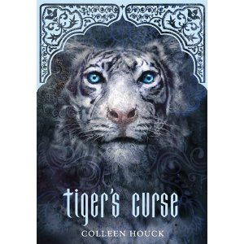
Tiger's Curse by Colleen Houck

Slide 27
The last thing teenager Kelsey Hayes thought she'd be doing over the summer was meeting Ren, a mysterious white tiger and cursed Indian prince! When she learns she alone can break the Tiger's curse, Kelsey's life is turned upside-down. The unlikely duo journeys halfway around the world to piece together an Indian prophecy, find a way to free the man trapped by a centuries-old spell, and discover the path to their true destiny.

Slide 28
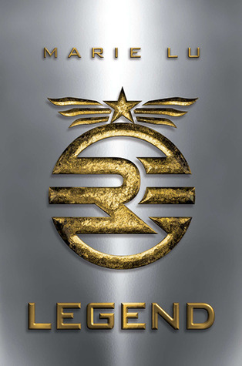
Legend by Marie Lu

Slide 29
What was once the western United States is now home to the Republic, a nation perpetually at war with its neighbors. Born into an elite family in one of the Republic's wealthiest districts, fifteen-year-old June is a prodigy being groomed for success in the Republic's highest military circles. Born into the slums, fifteen-year-old Day is the country's most wanted criminal. But his motives may not be as malicious as they seem.
From very different worlds, June and Day have no reason to cross paths - until the day June's brother, Metias, is murdered and Day becomes the prime suspect. Caught in the ultimate game of cat and mouse, Day is in a race for his family's survival, while June seeks to avenge Metias's death. But in a shocking turn of events, the two uncover the truth of what has really brought them together, and the sinister lengths their country will go to keep its secrets.
Full of nonstop action, suspense, and romance, this novel is sure to move readers as much as it thrills.

Slide 30

The Silence of Murder by Dandy Daley Mackall

Slide 31
Seventeen-year-old Hope Long's life revolves around her brother Jeremy. So when Jeremy is accused of killing the town's beloved baseball coach, Hope's world begins to unravel. Everyone is convinced Jeremy did it, and since he hasn't spoken a word in 9 years, he's unable to defend himself. Their lawyer instructs Hope to convince the jury that Jeremy is insane, but all her life Hope has known that Jeremy's just different than other people—better, even. As she works to prove his innocence—joined by her best friend T.J. and the sheriff's son, Chase—Hope uncovers secrets about the murder, the townspeople, her family, and herself. She knows her brother isn't the murderer. But as she comes closer to the truth, she's terrified to find out who is.

Slide 32
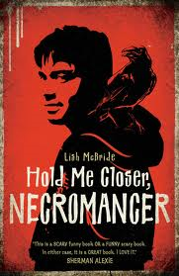
Hold Me Closer, Necromancer by Lish McBride

Slide 33
Sam leads a pretty normal life. He may not have the most exciting job in the world, but he’s doing all right—until a fast food prank brings him to the attention of Douglas, a creepy guy with an intense violent streak.
Turns out Douglas is a necromancer who raises the dead for cash and sees potential in Sam. Then Sam discovers he’s a necromancer too, but with strangely latent powers. And his worst nightmare wants to join forces . . . or else.
With only a week to figure things out, Sam needs all the help he can get. Luckily he lives in Seattle, which has nearly as many paranormal types as it does coffee places. But even with newfound friends, will Sam be able to save his skin?

Slide 34

Ghetto Cowboy by Greg Neri

Slide 35
When Cole’s mom dumps him in the mean streets of Philadelphia to live with the dad he’s never met, the last thing Cole expects to see is a horse, let alone a stable full of them. He may not know much about cowboys, but what he knows for sure is that cowboys aren’t black, and they don’t live in the inner city. But in his dad’s ’hood, horses are a way of life, and soon Cole’s days of skipping school and getting in trouble in Detroit have been replaced by shoveling muck and trying not to get stomped on. At first, all Cole can think about is how to ditch these ghetto cowboys and get home. But when the City threatens to shut down the stables— and take away the horse Cole has come to think of as his own— he knows that it’s time to step up and fight back. Inspired by the little-known urban riders of Philly and Brooklyn, this compelling tale of latter -day cowboy justice champions a world where your friends always have your back, especially when the chips are down.

Slide 36

This Dark Endeavor by Kenneth Oppel

Slide 37
The purest intentions can stir up the darkest obsessions.
In this prequel to Mary Shelley’s gothic classic, Frankenstein, 16-year-old Victor Frankenstein begins a dark journey that will change his life forever. Victor’s twin, Konrad, has fallen ill, and no doctor is able to cure him. Unwilling give up on his brother, Victor, his beautiful cousin Elizabeth, and best friend Henry begin a treacherous search for the ingredients to create the forbidden Elixir of Life.
Impossible odds, dangerous alchemy, and a bitter love triangle threaten their quest at every turn.
Victor knows he must not fail. But his success depends on how far he is willing to push the boundaries of nature, science and, love -- and how much he is willing to sacrifice.

Slide 38

Angel: A Maximum Ride novel by James Patterson

Slide 39
In the seventh book in the bestselling series, evil scientists are still trying to convince Max that she needs to save the world, this time by providing the genetic link in speeding up the pace of evolution. Worse, they're trying to convince her that her perfect mate is Dylan, the newest addition to the flock. The problem is that, despite herself, Max is starting to believe it.
Fang travels the country collecting his own gang of evolved humans, but the two separate flocks must unite to defeat a frightening doomsday cult whose motto is Save the Planet: Kill the Humans. And this time, the true heroine, for once, might just be little Angel.

Slide 40

The Adoration of Jenna Fox by Mary E Pearson

Slide 41
Who is Jenna Fox? Seventeen-year-old Jenna has been told that is her name. She has just awoken from a coma, they tell her, and she is still recovering from a terrible accident in which she was involved a year ago. But what happened before that? Jenna doesn't remember her life. Or does she? And are the memories really hers?
This fascinating novel represents a stunning new direction for acclaimed author Mary Pearson. Set in a near future America, it takes readers on an unforgettable journey through questions of bio-medical ethics and the nature of humanity. Mary Pearson's vividly drawn characters and masterful writing soar to a new level of sophistication.

Slide 42
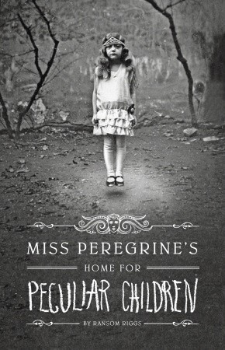
Miss Peregrine's Home for Peculiar Children
by Ransom Riggs

Slide 43
A mysterious island.
An abandoned orphanage.
A strange collection of very curious photographs.
It all waits to be discovered in Miss Peregrine’s Home for Peculiar Children, an unforgettable novel that mixes fiction and photography in a thrilling reading experience. As our story opens, a horrific family tragedy sets sixteen-year-old Jacob journeying to a remote island off the coast of Wales, where he discovers the crumbling ruins of Miss Peregrine’s Home for Peculiar Children. As Jacob explores its abandoned bedrooms and hallways, it becomes clear that the children were more than just peculiar. They may have been dangerous. They may have been quarantined on a deserted island for good reason. And somehow—impossible though it seems—they may still be alive. A spine-tingling fantasy illustrated with haunting vintage photography, Miss Peregrine’s Home for Peculiar Children will delight adults, teens, and anyone who relishes an adventure in the shadows.

Slide 44
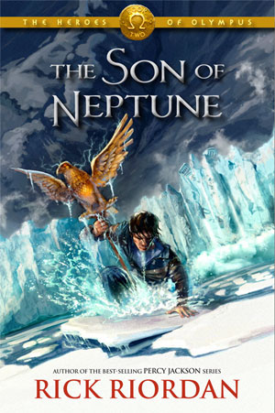
The Son of Neptune by Rick Riordan

Slide 45
Percy is confused. When he awoke after his long sleep, he didn't know much more than his name. His brain-fuzz is lingering, even after the wolf Lupa told him he is a demigod and trained him to fight. Somehow Percy managed to make it to the camp for half-bloods, despite the fact that he had to continually kill monsters that, annoyingly, would not stay dead. But the camp doesn't ring any bells with him.
Hazel is supposed to be dead. When she lived before, she didn't do a very good job of it. When the Voice took over her mother and commanded Hazel to use her "gift" for an evil purpose, Hazel couldn't say no. Now, because of her mistake, the future of the world is at risk.
Frank is a klutz. His grandmother claims he is descended from ancient heroes, but he doesn't even know who his father is. He keeps hoping Apollo will claim him, because the only thing he is good at is archery. His big and bulky physique makes him feel like a clumsy ox, especially in front of Hazel, his closest friend at camp. He trusts her completely-enough, even, to share the secret he holds close to his heart.
Beginning at the "other" camp for half-bloods and extending as far north as the land beyond the gods, this breathtaking second installment in the Heroes of Olympus series introduces new demigods, revives fearsome monsters, and features other remarkable creatures, all of whom are destined to play a part in the most important quest of all: the Prophecy of Seven.

Slide 46

Okay for Now by Gary D. Schmidt

Slide 47
In this companion novel to The Wednesday Wars, Doug struggles to be more than the "skinny thug" that some people think him to be. He finds an unlikely ally in Lil Spicer, who gives him the strength to endure an abusive father, the suspicions of a town, and the return of his oldest brother, forever scarred, from Vietnam. Schmidt expertly weaves multiple themes of loss and recovery in a story teeming with distinctive, unusual characters and invaluable lessons about love, creativity, and survival.

Slide 48

Between Shades of Gray by Ruta Sepetys

Slide 49
Fifteen-year-old Lina is a Lithuanian girl living an ordinary life--until Soviet officers invade her home and tear her family apart. Separated from her father and forced onto a crowded train, Lina, her mother, and her young brother make their way to a Siberian work camp, where they are forced to fight for their lives. Lina finds solace in her art, documenting these events by drawing. Risking everything, she imbeds clues in her drawings of their location and secretly passes them along, hoping her drawings will make their way to her father's prison camp. But will strength, love, and hope be enough for Lina and her family to survive?
This powerful tale of heartbreak and hope is sure to haunt readers long after they finish the last page.

Slide 50
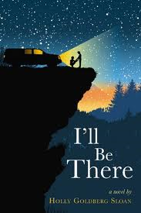
I'll Be There by Holly Goldberg Sloan

Slide 51
Sam Border wishes he could escape. Raised by an unstable father, he's spent his life moving from place to place. But he could never abandon his little brother, Riddle.
Riddle Border doesn't talk much. Instead, he draws pictures of the insides of things and waits for the day when the outsides of things will make sense. He worships his older brother. But how can they leave when there's nowhere to go? Then everything changes. Because Sam meets Emily.
Emily Bell believes in destiny. She sings for her church choir, though she doesn't have a particularly good voice. Nothing, she feels, is mere coincidence. And she's singing at the moment she first sees Sam.
Everyone whose path you cross in life has the power to change you--sometimes in small ways, and sometimes in ways greater than you could have ever known. Beautifully written and emotionally profound, Holly Goldberg Sloan's debut novel deftly explores the idea of human connection.

Slide 52

Scorpio Races by Maggie Stiefvater

Slide 53
Some race to win. Others race to survive.
It happens at the start of every November: the Scorpio Races. Riders attempt to keep hold of their water horses long enough to make it to the finish line.
Some riders live.
Others die.
At age nineteen, Sean Kendrick is the returning champion. He is a young man of few words, and if he has any fears, he keeps them buried deep, where no one else can see them.
Puck Connolly is different. She never meant to ride in the Scorpio Races. But fate hasn't given her much of a choice. So she enters the competition - the first girl ever to do so. She is in no way prepared for what is going to happen.
As she did in her bestselling Shiver trilogy, author Maggie Stiefvater takes us to the breaking point, where both love and life meet their greatest obstacles, and only the strong of heart can survive. The Scorpio Races is an unforgettable reading experience.

Slide 54

The Running Dream by Wendlin Van Draanen

Slide 55
Jessica thinks her life is over when she loses a leg in a car accident. She's not comforted by the news that she'll be able to walk with the help of a prosthetic leg. Who cares about walking when you live to run?
As she struggles to cope with crutches and a first cyborg-like prosthetic, Jessica feels oddly both in the spotlight and invisible. People who don't know what to say, act like she's not there. Which she could handle better if she weren't now keenly aware that she'd done the same thing herself to a girl with CP named Rosa. A girl who is going to tutor her through all the math she's missed. A girl who sees right into the heart of her.
With the support of family, friends, a coach, and her track teammates, Jessica may actually be able to run again. But that's not enough for her now. She doesn't just want to cross finish lines herself—she wants to take Rosa with her.

Slide 56
So get your team
and start reading, because…

Slide 57
Book War is fun …

Slide 58
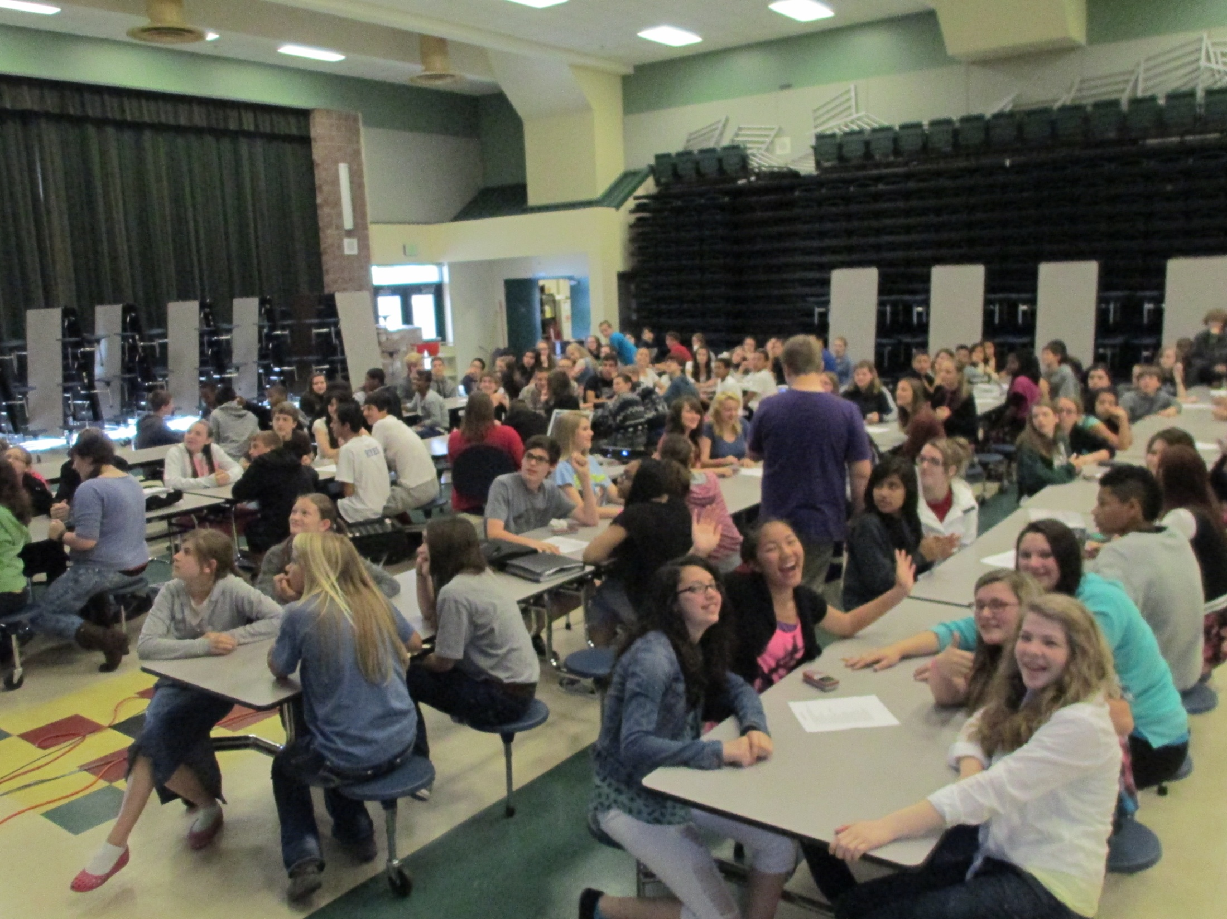

Slide 59
It’s challenging…

Slide 60
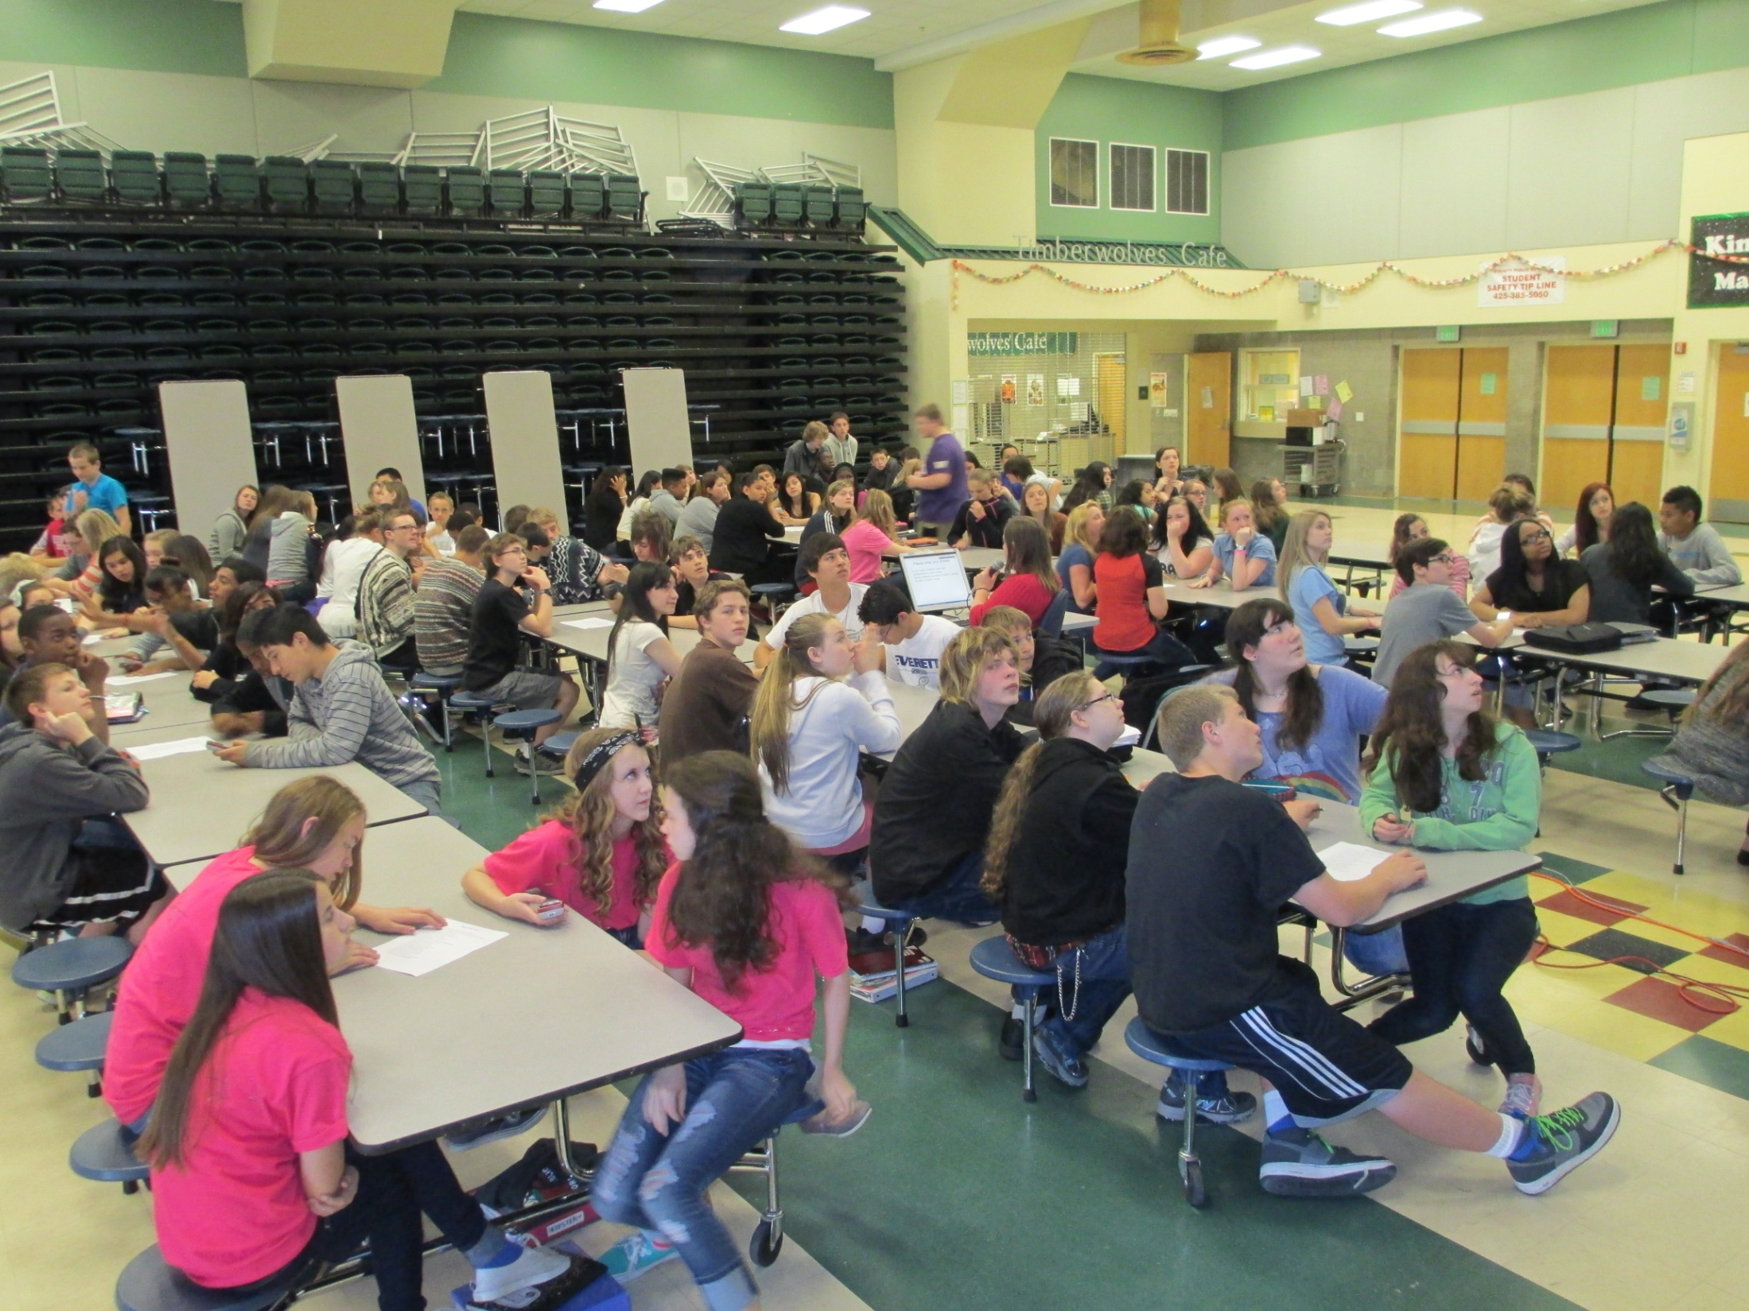

Slide 61
It’s the place to be at the end of the year!

Slide 62
