Slide 1


Library Partnership:
Connecting to Sno-Isle and Everett Public Libraries

Slide 2
Benefits of Using the Public Library
Sno-Isle | Everett Public
Check out 10 physical books | Check out 3 physical books
Access to ebooks and audiobooks | Access to ebooks and audiobooks
Access to free databases | Access to free databases
$7 printing credit
Brainfuse Live Tutoring

Slide 3
Your Log in for both libraries
Username: ES+StudentID (Example: ES98765)
Password: 1234

Slide 4

How to Log in to Everett Public Library

Slide 5

Step 1:
Go to: www.epls.org

Slide 6
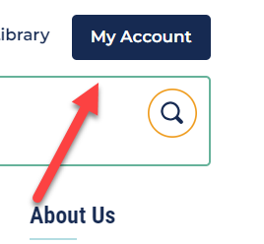
Step 2:
If you want to check out a book
Click on :

Slide 7
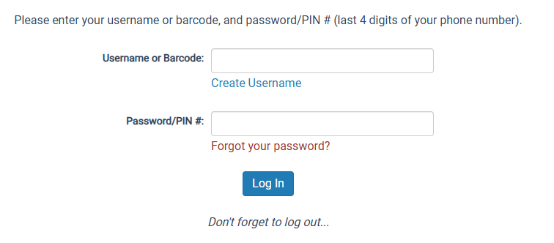
Step 3:
Type in your UserName and Password:

Slide 8
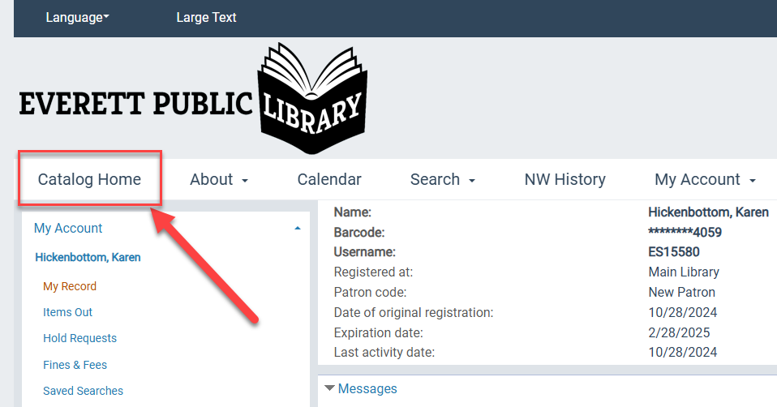
Step 4:
Click on Catalog to browse for books:

Slide 9
How to Log in to Sno-Isle Libraries

Slide 10

Step 1:
Activate your Account (You only have to do this part once)
Go to: https://www.sno-isle.org/

Slide 11
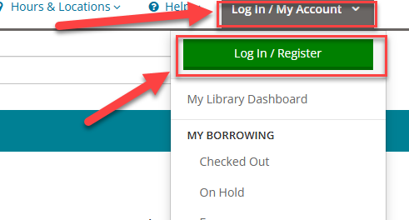
Step 2:
If you want to check out a book,
Click on:

Slide 12
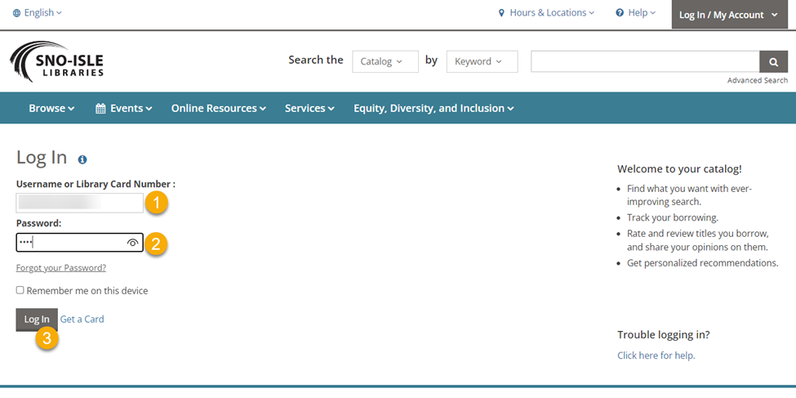
Step 3:
Enter your Username and password, then log iN:

Slide 13
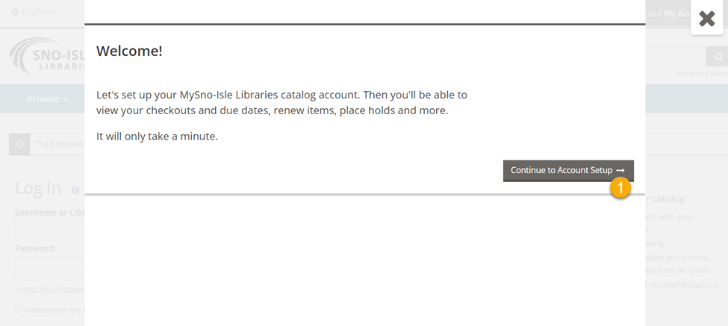
Step 4:
Click continue to account setup:

Slide 14
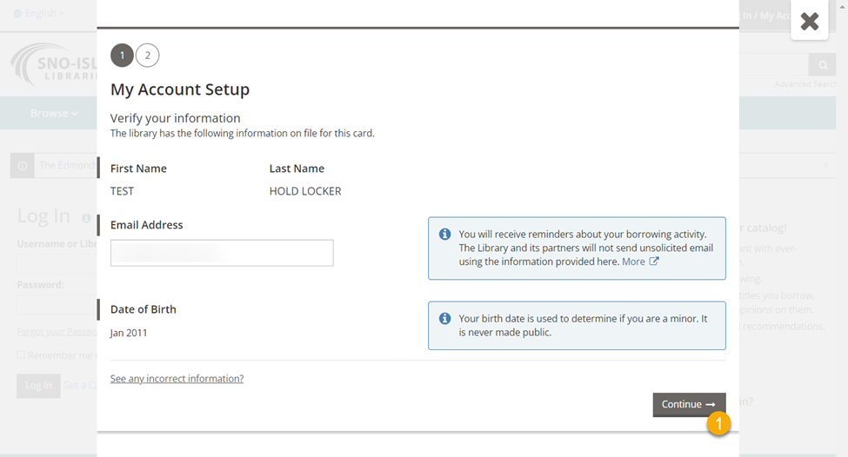
Step 5:
Your birthday was changed to protect your data. Click continue:

Slide 15
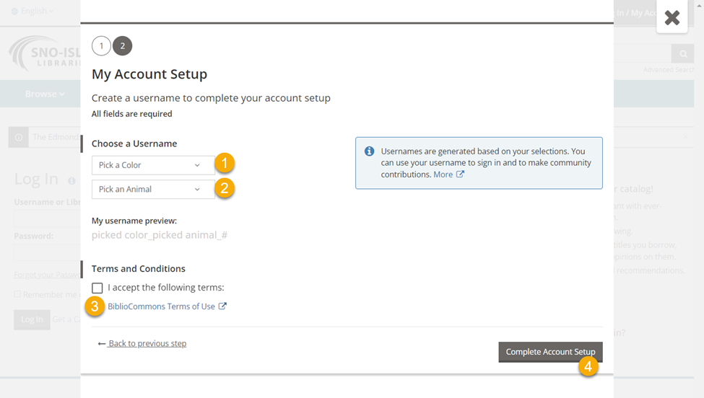
Step 6:
Pick a color and Animal. (You will not need to remember this!): Accept the Terms and click complete and then Continue on the next screen.

Slide 16
Step 7:
Your account is now activated! You can use your ES+StudentID to log in

Slide 17

Step 1:
Go to Managed Bookmarks and choose SORA

Slide 18
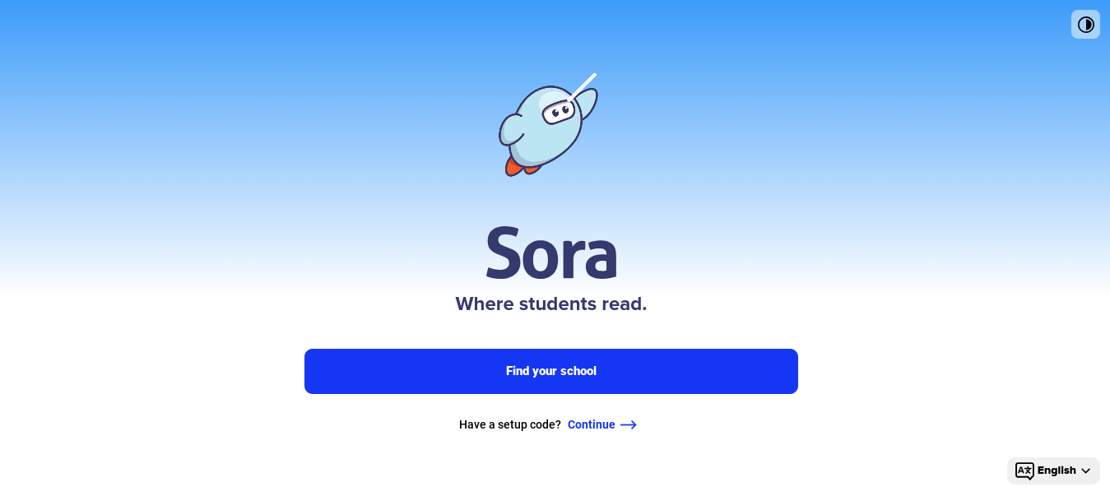
Step 2:
Click on Find your School

Slide 19
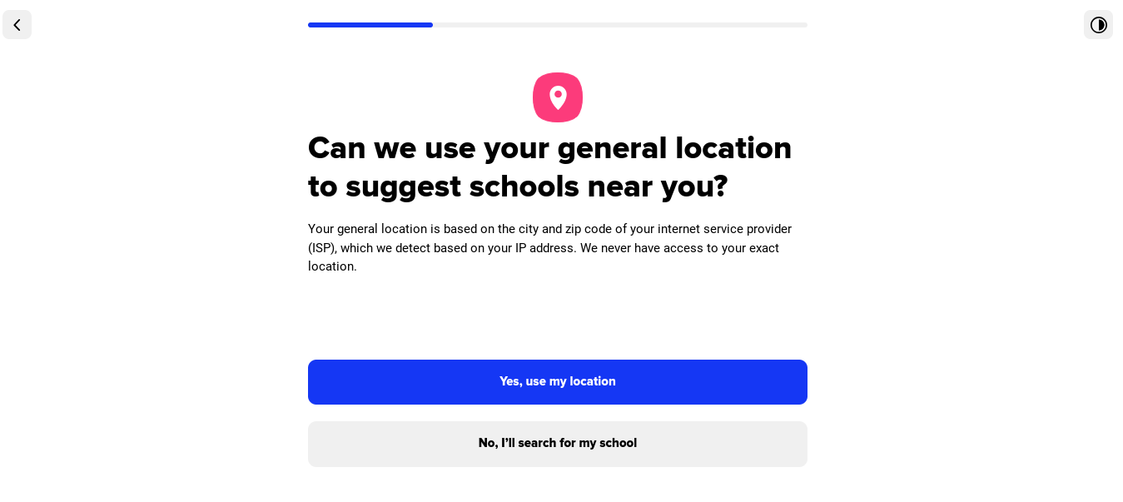
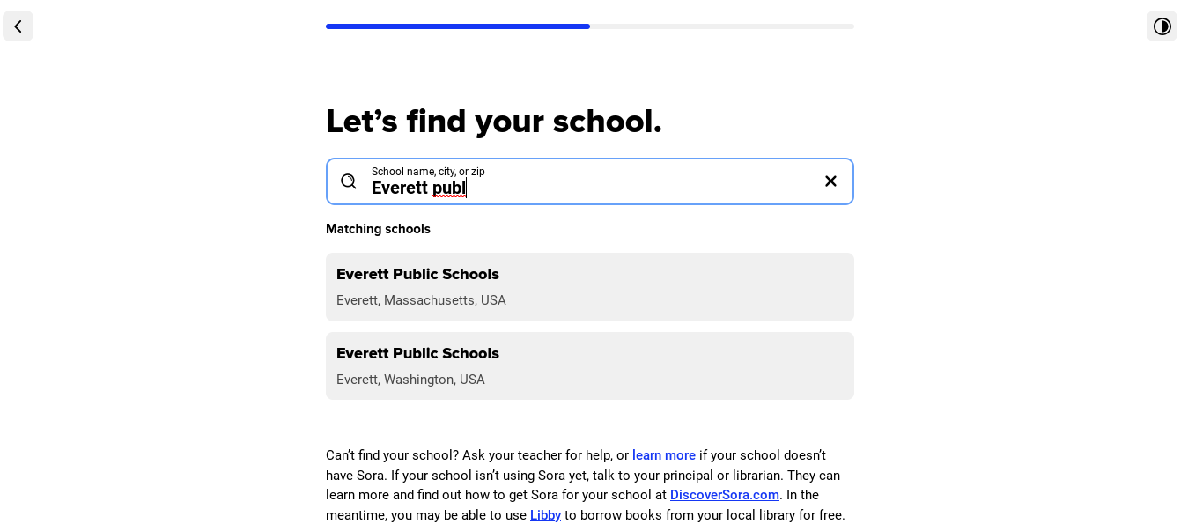
Step 3:
Click on “No, I’ll search for my School” and search for Everett Public schools

Slide 20
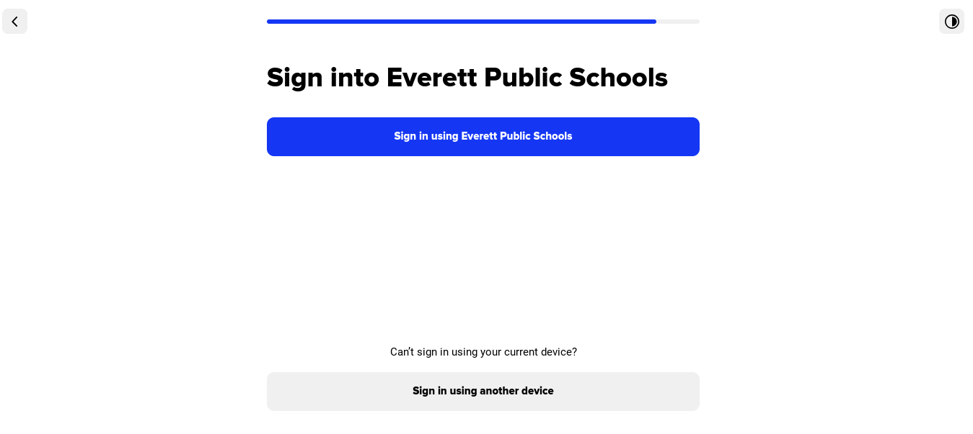
Step 4:
click the blue button

Slide 21
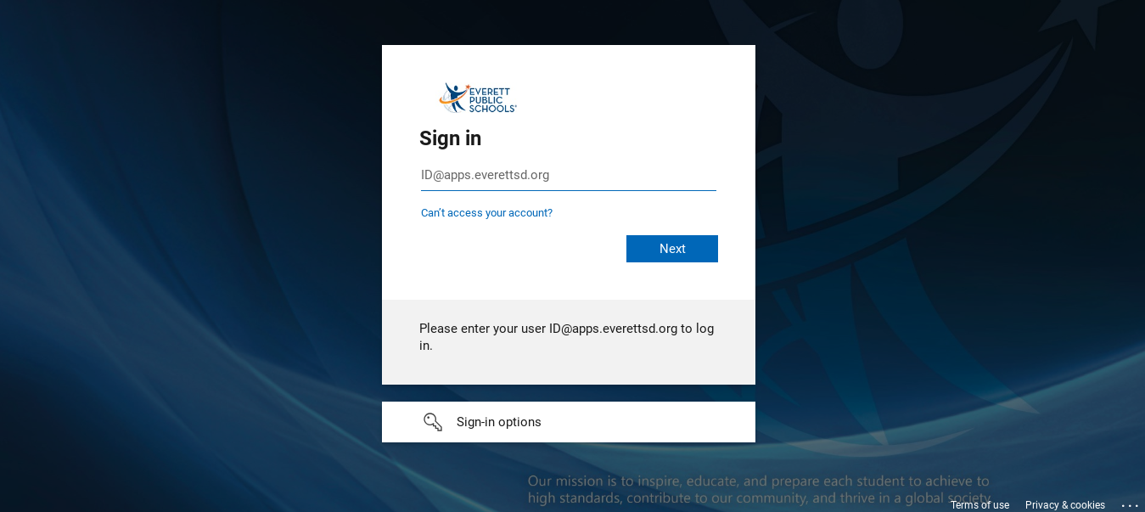
Step 5:
Log in with your District ID and password

Slide 22
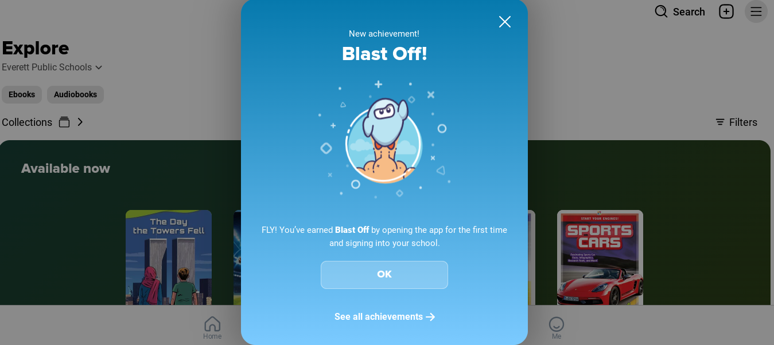
Step 6:
Here’s what you’ll see. You can close this window

Slide 23
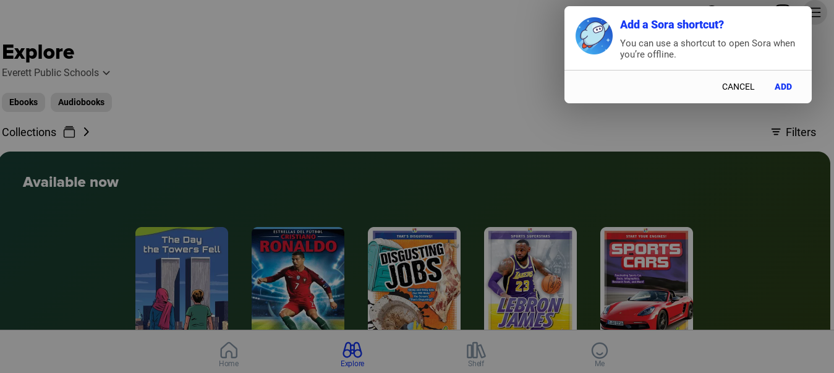
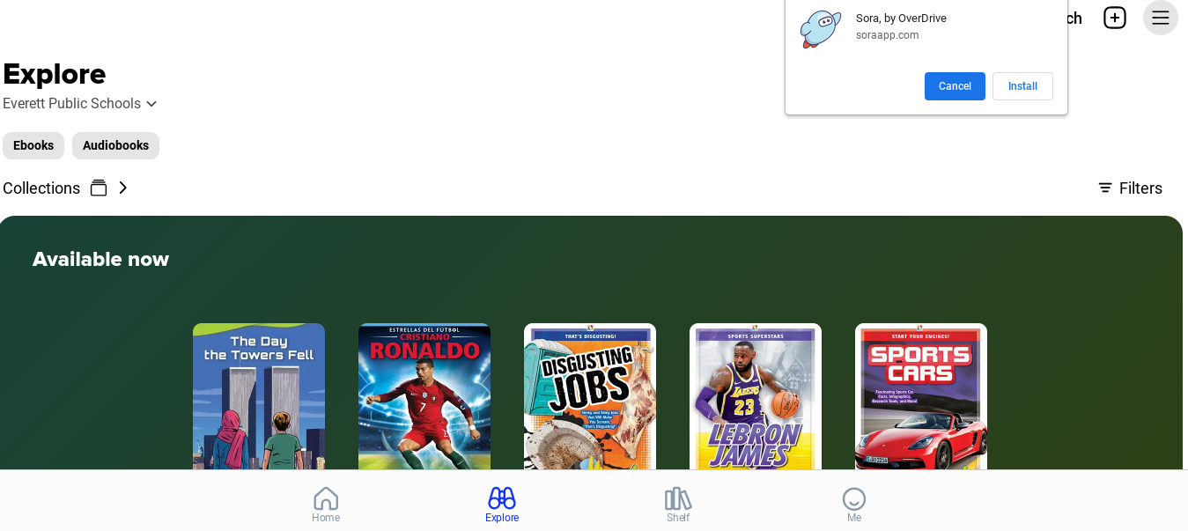
Step 7
It may ask you to add the shortcut. You can try it or close the windows

Slide 24
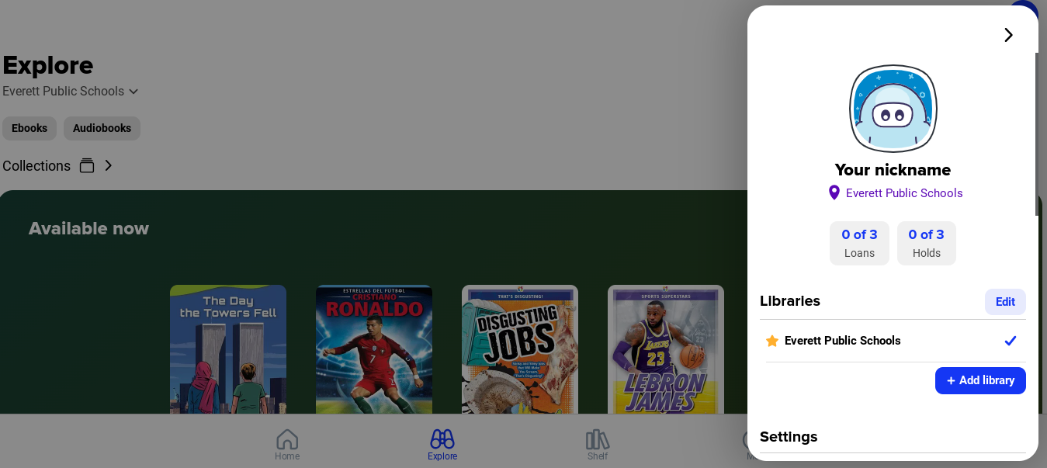
Step 8
To Add Sno-Isle and Everett Public Libraries, click on the three line menu in the top right. Then the blue +Add Library button

Slide 25
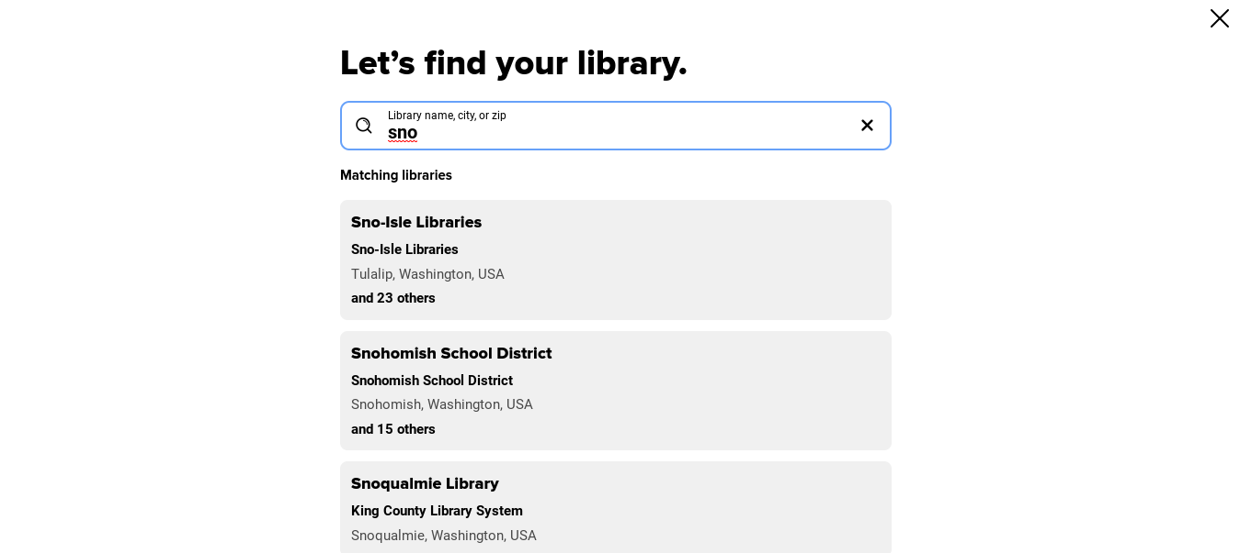
Step 9
Search for either of the libraries you want to add
Be careful! There is an Everett, Massachusetts with a public library

Slide 26
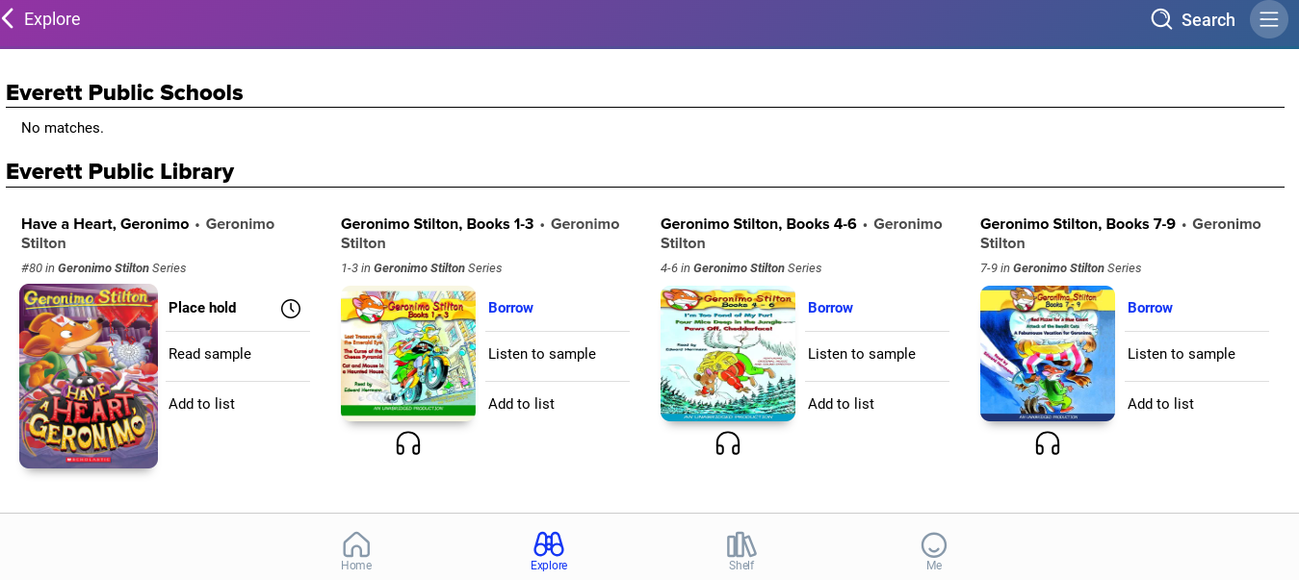
Step 10
Search for a book you are interested in. If you want to read it, click on Borrow

Slide 27
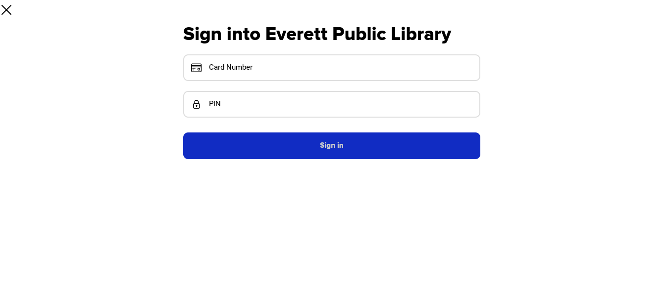
Step 11
Sign in with your ES+Student ID and password

Slide 28
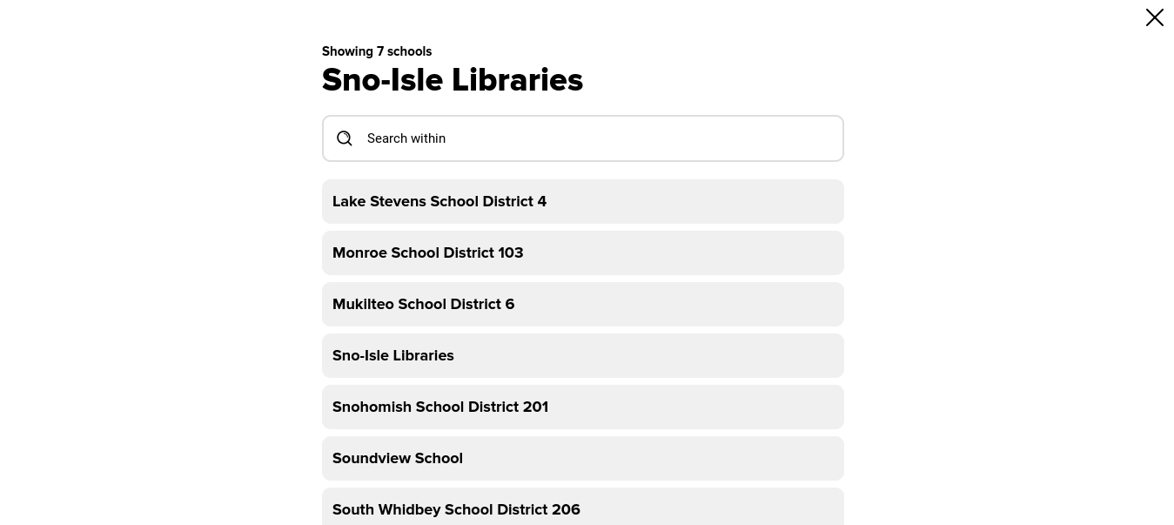
Step 12
When you borrow from Sno-Isle you’ll have to choose SNO-Isle the first time.

Slide 29
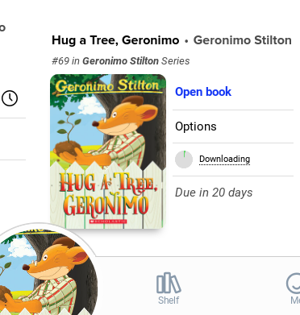
Step 13
After you login, click on Borrow again to access the book

