Slide 1
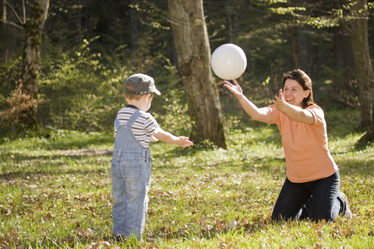
Ideas for Communication Practice at Home

Slide 2
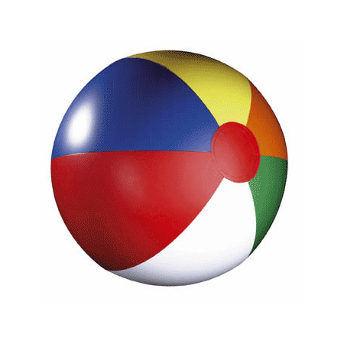
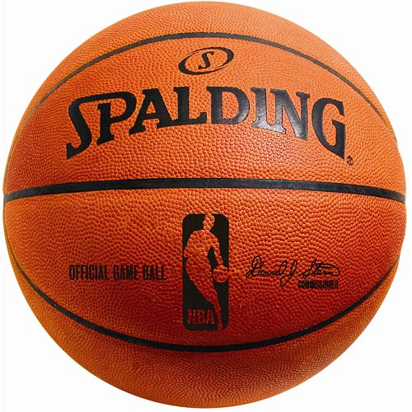
Ball play is simple and great for language practice! If your child doesn’t know the name of the ball, repeat it over and over as you play (i.e. “Pass the basketball. You caught basketball. Bouncy basketball!”, etc.). Practice verbs; bouncing, throwing, kicking, rolling, passing, getting, picking up, bringing, shooting, etc. Once YOU have the ball, look at your child and wait for them to initiate a request (i.e. My turn, Throw the ball, I want the soccer ball, etc.). If difficult, ask, “What do you want me to do? THROW ball or BOUNCE the ball?” “What do you want? The beach ball or the basketball?” Like a play by play announcer, you’re pretty much narrating everything your child is doing with the ball so he hears the verbs and phrases modeled. Eventually, the language will stick!

Slide 3
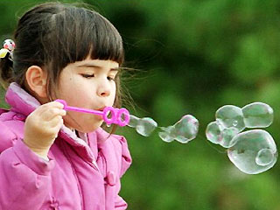
Bubbles are another GREAT way to practice language. Encourage requests like “I want the bubbles please”, practice rounding lips for blowing, and use phrases to describe the bubbles (i.e. “Those bubbles are small! Bubbles stuck together! Watch them float..over the fence! You blew one bubble! This bubble is sticky! A bubble landed on your nose! I will pop the big bubble!”, etc.).

Slide 4
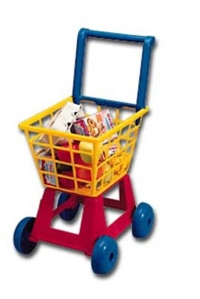
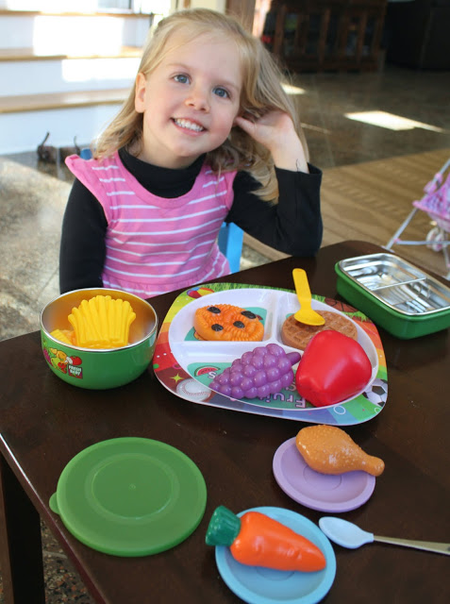
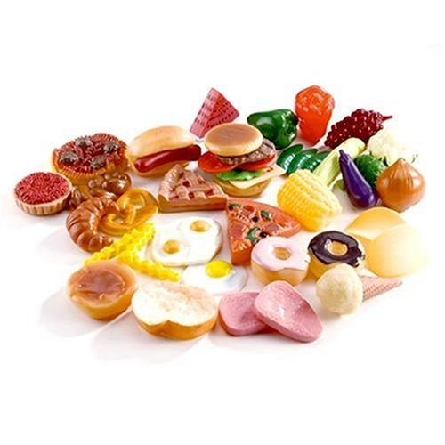
Toy food is a great way to practice pretend play and build language. You can set up a “grocery store” and go through the sequence of shopping, paying, and bagging the food. Or, set the table for a “meal.” Practice pronouns by giving your child directions like “Give a plate to ME. Now, YOU take a plate. Give a plate to HIM or HER(action figure, stuffed animal, doll) etc.” Your child can follow these types of commands w/ cups, napkins, plastic silverware, toy food, pretend juice, etc. You can also practice pronouns like “your” and “my” (i.e. Where’s YOUR cup? Where’s MY cup?etc.). Talk about HOW food tastes and feels (i.e. salty, chocolaty, spicy, tangy, crunchy, creamy, crispy).

Slide 5
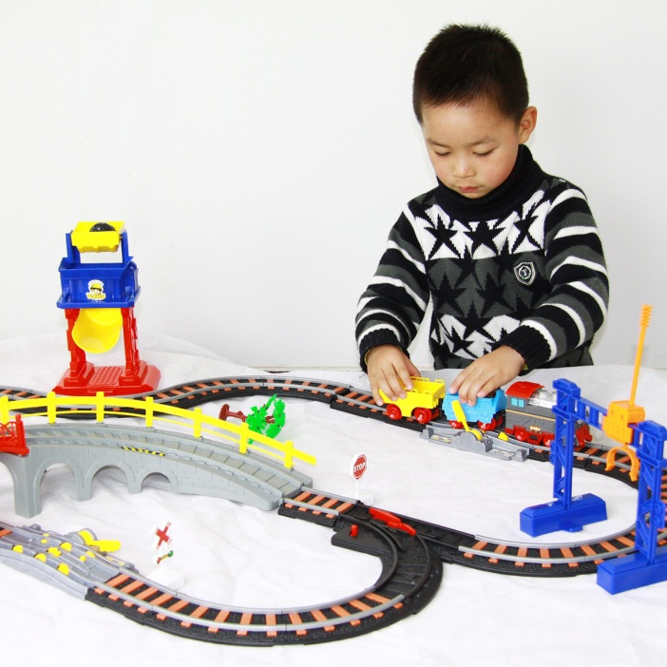
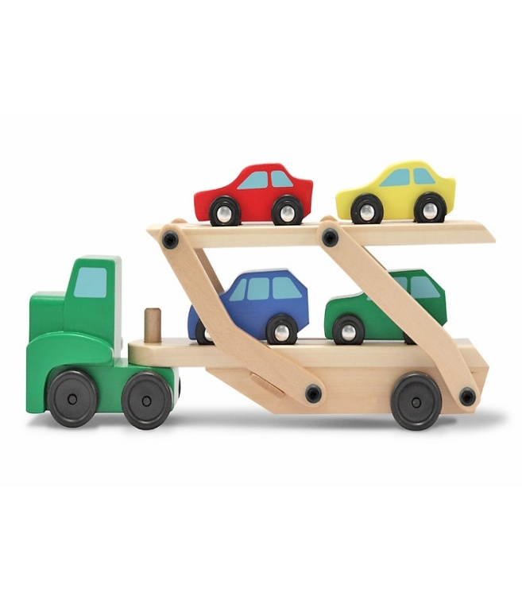
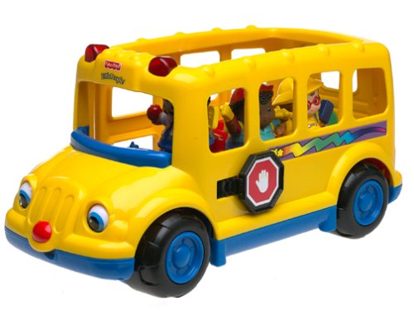
Vehicle play is awesome for language! You can model spatial words (“My car is on top”, “The train drives over the bridge”, “Dinosaur wants to sit in back of the bus”, “The kitty is sitting in front”), descriptive words (“I have a blue car”, “The school bus is dirty”, “There are two trucks on the road”), verbs (“Let’s fix the car”, “The bus breaks down”, “My plane is taking off”, “The monkey is climbing up the steps”, “My silver train needs gas”, “I will wash your car”). Practice identification and direction following, such as: “Where’s the BACK of the bus?”, “Where’s the FRONT of the car?”, “Where’s the wheel/window/door?”, “Make the bus go FAST!”, “Make train go SLOW”, “Hide car UNDER the bed”, “Hide the bus NEXT TO the couch!”, “Hide train IN BACK OF the chair”, “Which cars are the SAME/DIFFERENT?”, “Wash ONE car”, “Pump gas in ALL the cars.” Pretend the vehicles crash and break down so you can practice “fixing” them with pretend tools. Or “wash” them (“Help me wash the wheels. The wheels are dirty! Now let’s wash the windows. Filthy windows!”).

Slide 6
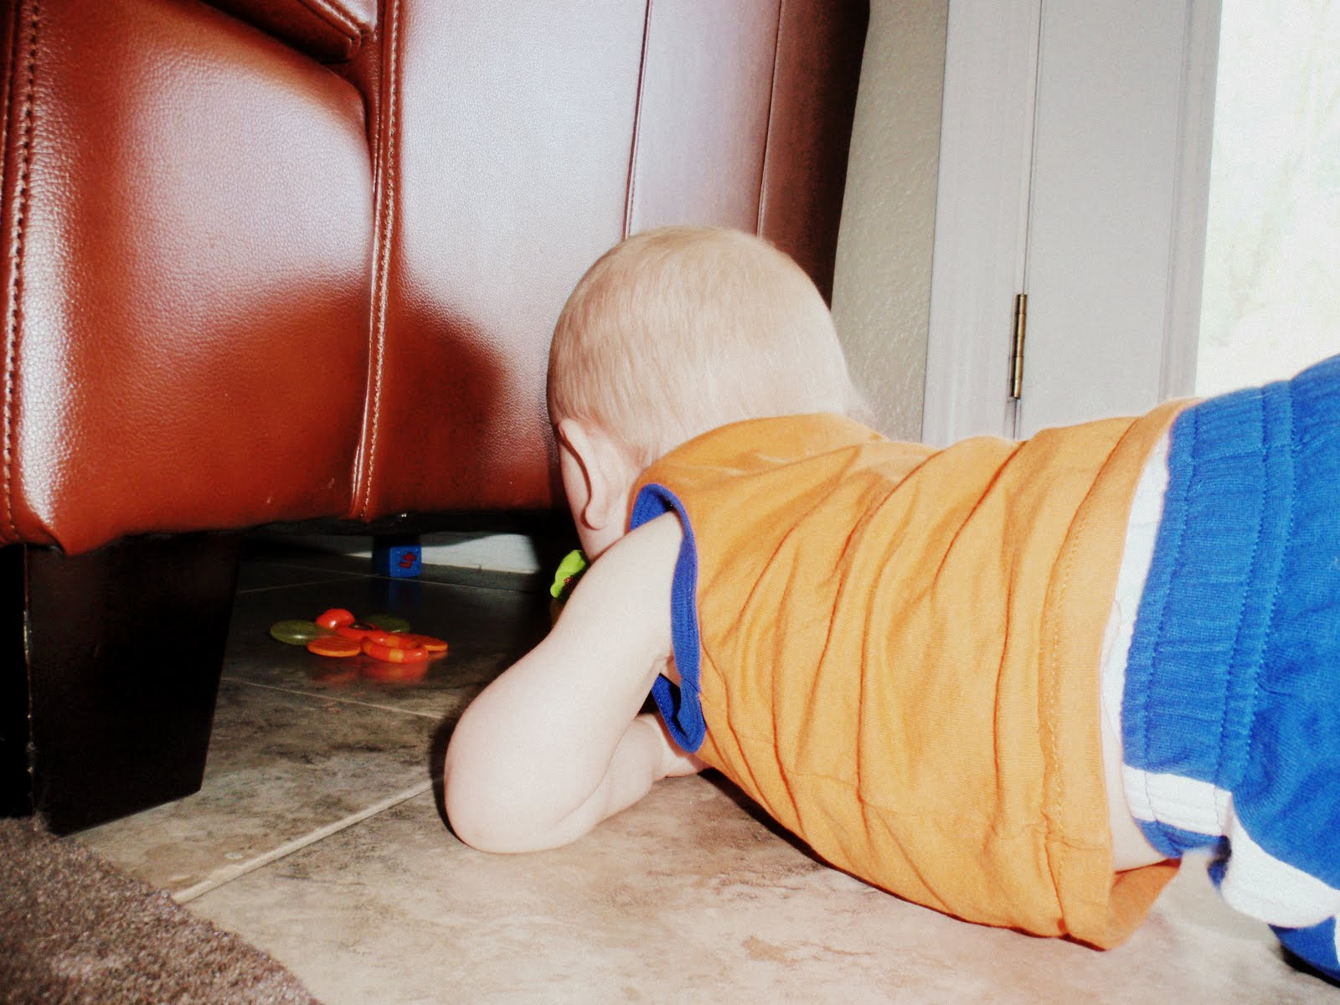
Play Hide and Seek with toys! Let your child hide a few toys around the room and, when you find them, talk about “where” they were hidden (“The truck was UNDER the couch!” “The block was NEXT TO the TV!”, etc.). Try giving spatial directions for hiding the toys (“Hide it IN BACK OF the couch”, “Hide it UNDER the blanket”) and let another parent or sibling “find.” You might want to stick with the same spatial word throughout the entire game to really help your child understand it. Another fun activity; hiding toys and letting your child search for them with a flashlight! (“Where was the lego? UNDER the chair or ON the chair?”). You can also reinforce these words by using hand motions around your own body; next to (place your hand on either side of you), behind (place your hand behind you), under (swing one hand under the other), etc.

Slide 7
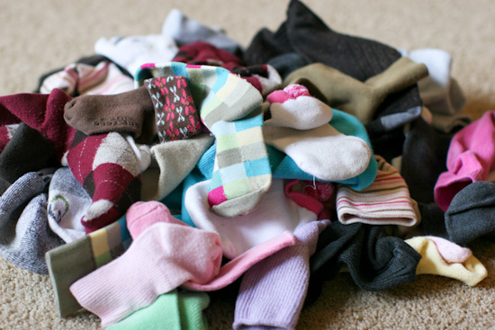
Sorting the laundry is a great way to practice language concepts! Practice finding socks that are the SAME or DIFFERENT. Lay out 3 socks, two that match and one that’s different. Ask your child to “Give me SAME” or “Give me DIFFERENT.” Talk about matches and count them (“One match, two matches”, etc.). Discuss “long” and “short” socks, or designs like “stripes, squares, spots”, etc.). Practice directions “Give me ONE sock”, “Give me one MORE sock”, “Give me MANY socks”, “Give me ALL of the socks”, etc.). Ask “Whose socks are these?” to practice phrases like “Dad’s socks”, “My socks”, “Your socks.” Ask, “Whose socks are biggest? Smallest?” Practice telling the laundry sequence: “First we wash our socks. Then we dry them. Last, we match them up and put them away. They are clean!” Ask, “WHERE do we wash/dry/keep socks?

Slide 8
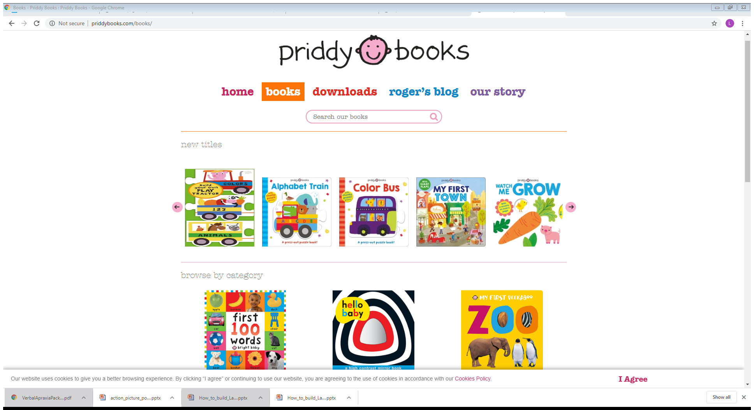
http://www.priddybooks.com/books/ This is one of my favorite book publishers for early learning and vocabulary. If you go to their website and click on “shop”, there is a wide variety of books, including board books, lift the flap, cloth, sound, touch & feel, etc. ***Even though the baby/toddler books seem too young, they are the most interactive and offer the clearest pictures for building early vocabulary!

Slide 9
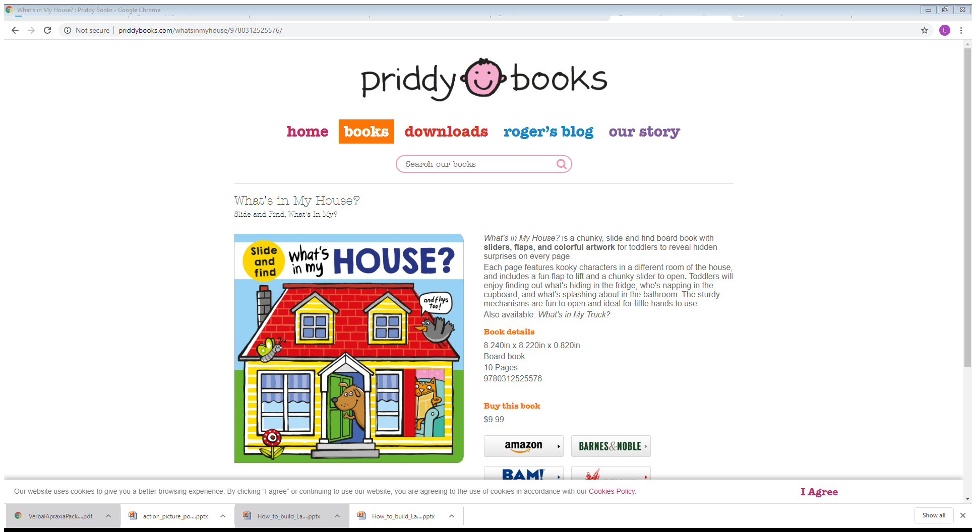
This is one of my favorite picture books for vocabulary by Priddy Books. You can talk about the silly scenes, using home vocabulary, with 4-5 word sentences, like “An octopus in the washer!”

Slide 10
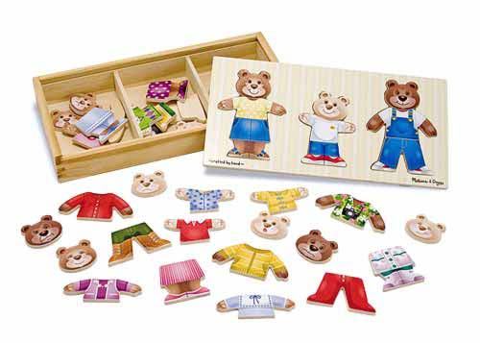
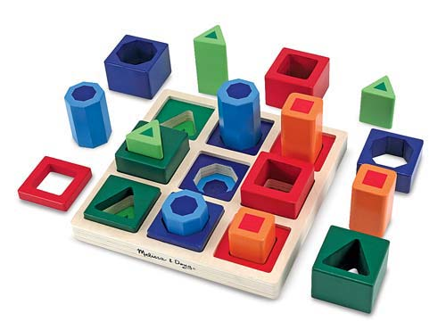
http://www.melissaanddoug.com/ Melissa and Doug is a company that offers amazing learning toys for young children! Their products are sold at Kohls, Bartells, Amazon, etc. In my experience, Melissa and Doug toys have been the most effective in motivating my students to imitate and talk! I’ve shared some of my favorites! If we’re dressing the bears, I hold up two choices (all the materials are out of reach to the child) and ask, “Which one do you want?” If the child just points, I name the two choices to encourage repetition “The blue coat.. Or the red coat?” Same with the shapes; “The small orange..or the large orange?” You can say.. “I want the small orange please.”

Slide 11
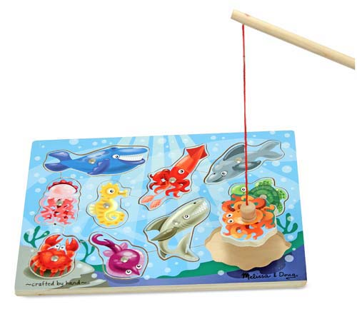
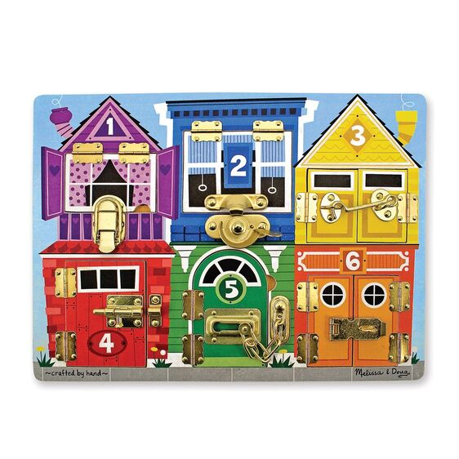
Melissa and Doug puzzles
Great for TURN TAKING! Practice phrases like “my turn” and “your turn.” Practice requests, like “Pass the fishing pole please” or “Help me catch the seahorse”. Practice pronouns like “I” (“I caught a fish!”) and “you” (“You caught the gray shark”). Practice vocabulary for ocean animals and using descriptive phrases (“yellow seahorse”, “jiggly jellyfish”, “the crab’s pinchers are sharp”). Practice answering What and Who questions (What did you catch? Who caught the turtle?).
Great for practicing description! Kids love locks, so take advantage and have fun talking about HOW to unlock all of the different colored homes. Discuss color and numbers; “Which house should we unlock/lock now? The Blue Number 2 or the Yellow Number 3? Talk about movement and motion; We moved it sideways, we lifted it up and clicked it, we hooked the latch, etc. Talk about the shapes of the windows, roofs, doors, etc. Lock the door incorrectly, on purpose! Your child will need to use specific words to help you out!

Slide 12
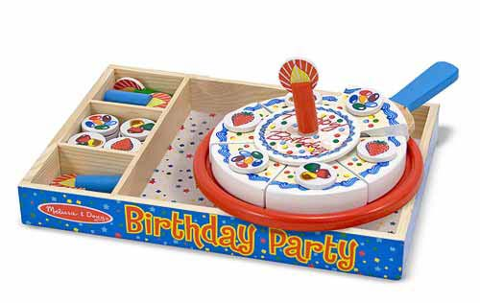
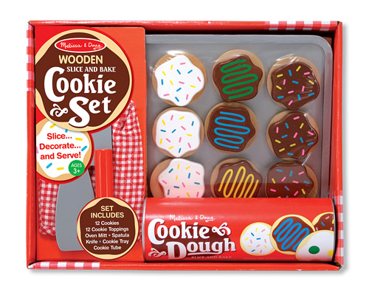
More Melissa and Doug Toys!
This is one of my favorite toys to use with ANY child. The pieces attach together with Velcro. Practice cutting apart the cookies with the knife (great sensory experience). Turn taking and requesting can be practiced (“Can I have the knife please?”, “It’s my turn to cut apart”, “I want the chocolate with sprinkles”). Spatial words and phrases can be practiced (“I’m setting the cookies on the sheet”, “My cookie is too hot. I need to blow on it”, “It’s time to take cookies off”, “These cookies are delicious. I want another!”). I like to put the cookies in the oven (create a spot for make believe oven) and set a real timer for 30 seconds or so before hearing the ding (“Cookies are ready!”). Then, practice wearing the oven mitt to take the hot cookies out! Blow on them; “Cookies are hot!” Have fun finding cookie matches..
Have a pretend birthday party for a family member, stuffed animal, pet, etc. Keep all of the parts out of reach so your child is forced to use words when requesting. Hold up candy, strawberry, and/or candle to practice requesting “I want jelly beans”, “Can I have a strawberry please?”, “Please pass a blue candle”, etc. Ask “Where does candy go?” (on cake). Sing the “Happy birthday” song, give cake to birthday person, and practice “blowing” out candles. Take turns “cutting” the cake (“I want to cut”), opening presents (put toys from around the house in a gift bag), taking pictures, and pretending to eat(“Yummy cake!”).

Slide 13
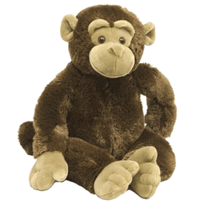
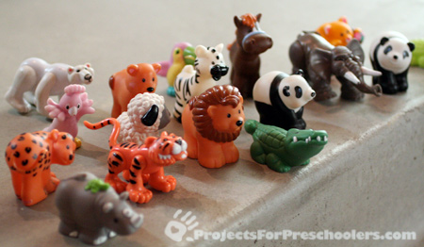
The plastic animals on the left are from “Little People” play sets. You can buy them online at fisherprice.com, at toy stores, or at yard sales (much cheaper!!!). They are great for working on direction following. Use a large stuffed animal, couch, or toy car, etc. with the plastic animals and give spatial directions for “in back of” (Put tiger “in back of” monkey), “in front of” (Put sheep “in front of” car), “next to” (Put lion “next to” couch), “under” (Put bear “under” monkey), and “over” (Make crocodile jump “over” car). Just practice one type of spatial word at a time until your child learns it. Later, you can intermix.☺

Slide 14
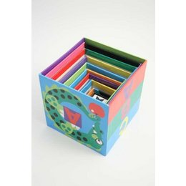
Here are MORE ways you can use Little People animals to practice direction following. Take 2-3 larger boxes (or nesting boxes shown below) and set near child. Then, display 3-4 animals in front of you. Tell your child, “Get ALL”; they can put in or on the boxes. If they just take “one”, motion with your finger toward “all” the animals and model. Later, practice “Get ONE.” If successful, you can intermix the commands. Practice “in”, “on top” and “under” by turning two boxes upside down and two others right side up. Give child animal, saying “Put ON TOP”, “IN”, or “UNDER.” If difficult, just work on one concept repeatedly until mastered!

Slide 15
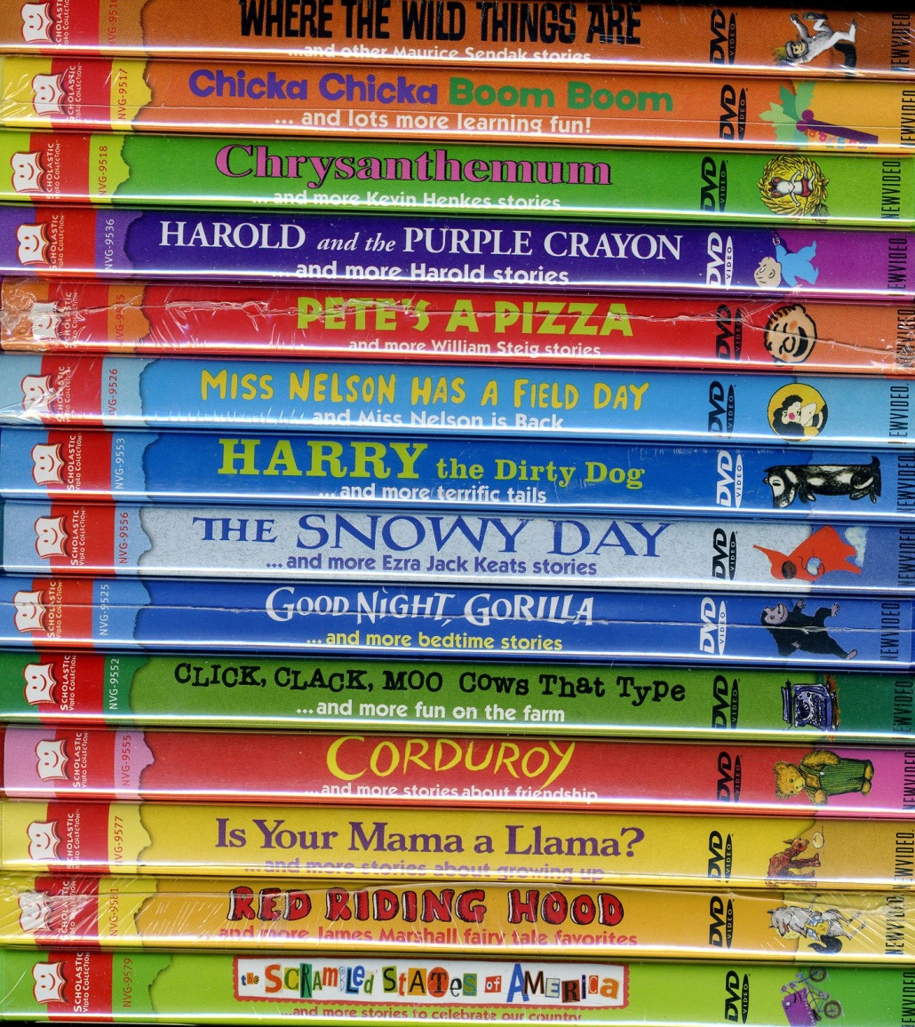
In preschool, many of our curriculum stories come in video format as well, which reinforces the vocabulary and story sequence even more! Below shows many of the videos that are part of the Scholastic Video Collection, sold on Amazon. You can also order them individually through Amazon. Some examples of great videos: The Sleeping House, The Snowy Day, Is Your Mama a Llama?, Good Night Gorilla, Bark George, Curious George Rides a Bike, Good Night Moon, Bear Snores On, etc.

