Slide 1
Things Fall Apart
Chinua Achebe

Slide 2
About the Author
Chinua Achebe (1930–2013), the son of a Christian minister, was one of Nigeria’s most celebrated novelists. Born an Ibo in Ogidi, Nigeria, in 1930, Achebe was educated in English. Achebe taught English at the university level at colleges in Africa and the United States. His first and best-known novel, Things Fall Apart, was published in 1958. Achebe wrote several novels, short story collections, and books of essays.

Slide 3
Predictions
As you examine the cover and epigraph of Things Fall Apart, what predictions can you make about the novel? Consider the title. To what “things” might Achebe be referring?
Look up the definition of epigraph if you don’t know what it means and add the definition to your Unit 3 notes.

Slide 4
Pronunciations
Copy the following names and pronunciations onto a blank bookmark supplied by your teacher. Things Fall Apart focuses on a culture that may be unfamiliar to you. Even though the novel is written in English, the author uses words and phrases from his native Ibo language. Review the glossary at the back of the novel. Add additional words and definitions to your bookmark as you read. Consider including: chi, ilo, nza, and obi.

Slide 5
Copy these names and pronunciations onto your bookmark
Achebe (Ah-chay-bay)
Chinua ( Chin-oo-ah)
Ekwefi (Eh-kweh-fee)
Ezinma (Eh-zeen-mah)
Ikemefuna (Ee-keh-meh-foo-nah)
Obierika (Oh-bee-air-ee-kah)
Nwoye (Nuh-woh-yeh)
Ojiubo (Oh-jee-ooh-boh)
Okonkwo (Oh-kawn-kwoh)
Umuofia (Oo-moo-oh-fee-ah)
Unoka (Ooh-no-kah)

Slide 6
Proverbs and Folktales
Learning Targets:
Examine thematic connections between proverbs and folktales.
Predict how and why an author uses proverbs and fables in a novel.

Slide 7
Proverbs and folktales
Proverbs and folktales are one part of a culture’s oral tradition. People share proverbs and folktales in order to express important stories, ideas, and beliefs about their culture.
As you read the novel Things Fall Apart, you will encounter many proverbs and folktales that illustrate the beliefs of the Ibo people. One memorable Ibo proverb is “Proverbs are the palm oil with which words are eaten.” Explain what you think this proverb means.

Slide 8
Proverbs and Folktales
Proverb | Explanation
If a child washes his hands, he could eat with kings.
When the moon is shining, the cripple becomes hungry for a walk.
Since men have learned to shoot without missing, [the bird] has learned to fly without perching.
The clan was like a lizard. If it lost its tail it soon grew another.
I cannot live on the bank of a river and wash my hands with spittle.
A man who pays respect to the great paves the way for his own greatness.

Slide 9
Proverbs and Folktales
Proverb | Explanation
If a child washes his hands, he could eat with kings. | Cleanliness is a virtue (e.g., cleanliness is next to godliness).
When the moon is shining, the cripple becomes hungry for a walk. | Some opportunities are just too good to resist.
Since men have learned to shoot without missing, [the bird] has learned to fly without perching. | Adaptation is the key to survival.
The clan was like a lizard. If it lost its tail it soon grew another. | If a role within the community became vacant, someone would soon fill it.
I cannot live on the bank of a river and wash my hands with spittle. | Why should I settle for less, when I could have better?
A man who pays respect to the great paves the way for his own greatness. | One is more likely to receive respect when one shows respect to others.

Slide 10
Entry Task
February 17, 2016
Respond to the following questions in the “Entry Task” section of your notebook. Try to write ½ page.
How are father/son relationships complicated?
What might fathers and sons have in common?
What might make them different?

Slide 11
SB Activity 3.5: Father and Son
Learning Targets:
Analyze how a complex character interacts with other characters.
Analyze how a complex character’s motivation advances the plot.
Literary Terms: Define these terms:
Motif
Foil

Slide 12
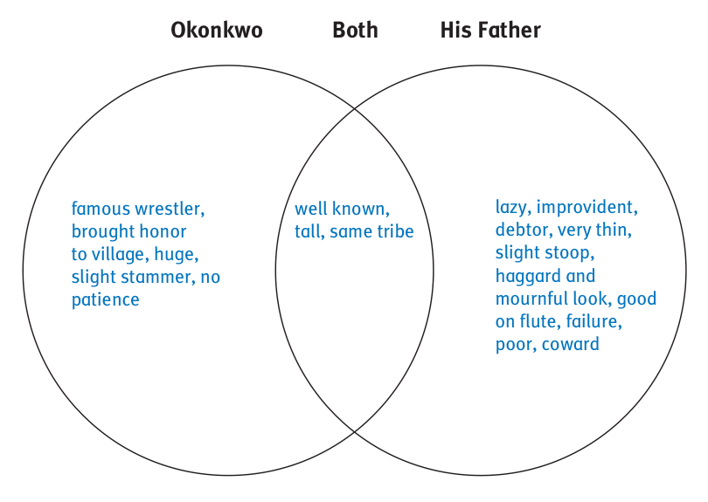
As you read, use the organizer below or create one of your own to compare and contrast Okonkwo and his father. Record facts and details about each.

Slide 13
Language and Writer’s Craft: Active and Passive Voice
Active voice occurs when the subject of a sentence performs the action; for example: “In the end, Okonkwo threw the Cat.” Okonkwo performs the action of throwing. Passive voice is when the subject of the sentence receives the action; for example: The Cat was thrown by Okonkwo.
Use active voice in your writing to enhance clarity.

Slide 14
Writing Prompt
How is Okonkwo’s character influenced by his complex relationship with his father? Be sure to:
Include a topic sentence that compares or contrasts the two characters.
Use specific details and quotations from the novel as support.
Use active voice.

Slide 15
Entry Task
Listen to the song “Father and Son” by Cat Stevens. Jot down the main idea/theme of the song.
How is the father archetype portrayed in this song?
How is it similar or different than how the father archetype is portrayed in Things Fall Apart?

Slide 16
Double-Entry Journal
Look for examples of Okonkwo’s feelings and fears, the reasons for those fears, and the effect they have on his actions. Also look for a motif or foil.
Include textual evidence from each chapter in the left-hand column.
Write your personal response or interpretation in the right-hand column.

Slide 17
Double-Entry Journal
Feelings and Fears: Passage from the Text | Personal Response or Interpretation
Example: “But his whole life was dominated by fear, the fear of failure and of weakness.” (Ch. 2) | I wonder why Okonkwo is so afraid. How could he be a successful wrestler if he is dominated by fear?

Slide 18
Double-Entry Journal
Feelings and Fears: Passage from the Text | Personal Response or Interpretation
Example: “But his whole life was dominated by fear, the fear of failure and of weakness.” (Ch. 2) “He had no patience with unsuccessful men.” (Ch. 1) “Okonkwo’s first son, Nwoye, was then twelve years old but was already causing his father great anxiety for his incipient laziness.” (Ch. 2) “And indeed he was possessed by the fear of his father’s contemptible life and shameful death.” (Ch.3) “Okonkwo never showed any emotion openly, unless it be the emotion of anger. To show affection was a sign of weakness; the only thing worth demonstrating was strength.” (Ch.4) | I wonder why Okonkwo is so afraid. How could he be a successful wrestler if he is dominated by fear? Okonkwo’s frustration with his father’s faults carries over into his feelings towards others. Since Okonkwo’s father is dead, his son is taking over as a foil. Father/son tension may be a motif. Okonkwo became prosperous because of his fear of being like his father. Can a lazy father be more inspiring than a hardworking father? Okonkwo’s character is warped by his desire not to appear weak like his father. The only emotion he is willing to show is anger.

Slide 19
Entry Task
February 24, 2016
Listen to the song “Cat’s in the Cradle” by Harry Chapin. Jot down the main idea/theme of the song.
How is the father archetype portrayed in this song?
How is it similar or different than how the father archetype is portrayed in Things Fall Apart?

Slide 20
Check Your Understanding
What conflicts already existed in the Ibo culture before the arrival of the colonists?
How is Unoka (Okonkwo’s father) set up as a foil to Okonkwo?
Predict how father/son tensions could be a motif in this novel.

Slide 21
Literary Analysis Paper
After completing Things Fall Apart, everyone will write a Literary Analysis Paper on the following prompt:
Analyze how the depiction of __________ shapes the meaning of the work as a whole. You should look especially at how the introduction of colonialism affects the meaning that surrounds your area of inquiry.
Father / Son Relationships
What Makes A Society Civilized
Cultural Collisions (Conflict)
Gender Roles
The Use Of Violence
Acts Of Sacrifice

Slide 22
Character in Conflict
Fill in the chart below to explore the conflicting sides of Okonkwo’s character.
Okonkwo’s Achievements and Status | Negative Traits and Actions

Slide 23
Character in Conflict
Okonkwo’s Achievements and Status | Negative Traits and Actions
A great wrestler Wealthy farmer A great warrior Hard worker Religious Respectful to community elders Supported his mother and sisters Doesn’t give up Careful farmer Rose to greatness from poverty | Hot temper Fear of weakness Fear of being like his father Nags and beats his son Insults unsuccessful men Can’t show emotion Beats his wife Forgets the Week of Peace Won’t admit wrongdoing Critical of his sons

Slide 24
Create the graphic organizer to begin Okonkwo’s family tree.

Slide 25
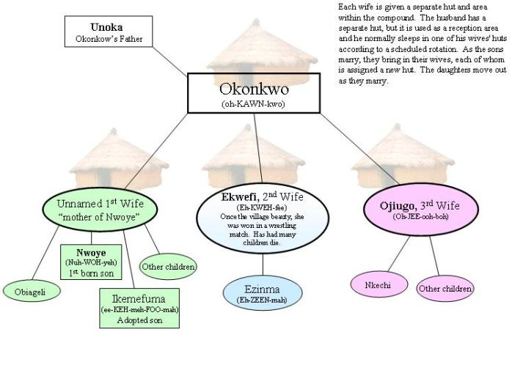
Okonkwo’s Family Tree

Slide 26
Creating an Ibo Tableau
Work with your group members to create a tableau (a freeze-frame snapshot) of characters from Things Fall Apart.
Review the basic facts about your character. Write a short statement that your character will give. The statement should begin with “I am …”; then state your character’s name and reveal an interesting fact about that character. Just as the characters’ positions in the tableau will explain their relationships with one another, try to let the lines you write and the way you deliver them reveal your character’s attitude and personality.
Work with your group to decide where each character should stand, how he or she should pose, and where he or she should be positioned in relation to others. Be prepared to present your tableau to the class. You and fellow characters should strike the pose and then step out of the freeze-frame one at a time to deliver your lines.

Slide 27
Entry Task
Respond to the following question:
What is your definition of a civilized society?
A civilized society is one in which….
Be prepared to share your ideas with the class.

Slide 28
Is the Ibo culture, as presented in the novel, a civilized society?
Yes | No

Slide 29
Is the Ibo culture, as presented in the novel, a civilized society?
Yes | No
They have strong religious beliefs: they celebrate and respect the Week of Peace. Their culture rewards hard work: Okonkwo is respected and given authority due to his industrious nature. They have a strong sense of community and justice: there are customs in place to avoid war, such as the treaty in which Ikemefuna was sent to Umuofia as atonement. They respect familial bonds: Okonkwo supports his mother and the rest of his family when he begins to make money. | They are violent: Okonkwo beats his wife for a minor offense. They kill human beings: Ikemefuna is slaughtered senselessly, and twins are left to die in the forest. They have flexible matrimonial bonds: men take multiple wives and Ekwefi left her first husband for Okonkwo. They drink alcohol and admire men for their wrestling skills.

Slide 30
Writing Prompt
Explain how the Ibo culture depicted in Things Fall Apart represents a civilized or uncivilized society. Be sure to:
Include a thesis statement that responds to the prompt.
Include textual evidence from the novel, including direct quotations.
Use precise language and detail to describe the Ibo culture.

Slide 31
Acts of Violence
Learning Targets:
Analyze how a them is developed over the course of a novel.
Outline Okonkwo’s violent tendencies and their consequences.

Slide 32
Acts of Violence
While at public gatherings, observances of rites, or festivals, Okonkwo often commits acts of violence that ruin the occasion and generate public disapproval. Review Part 1 and complete the graphic organizer below to identify Okonkwo’s violent acts and their consequences.
Violent Acts | Consequences

Slide 33
Acts of Violence
Violent Acts | Consequences
Beating his wife during the Week of Peace. Killing Ikemefuna. Killing Ezeudu’s son by accident. | He is chastised by the priest and has to make reparations. He distances himself from his son Nwoye and is criticized by clan elders. He is exiled from the clan.

Slide 34
Thesis Statement
Work alone or with a partner to construct a thesis statement on the theme of Okonkwo’s violent tendencies and their consequences.

Slide 35
Example Thesis Statement
Okonkwo’s violent tendencies lead to his alienation from his family and community.
Other examples?

Slide 36
Writing Prompt
Consider Okonkwo’s acts of violence throughout the course of the novel. Explain how the actions of this complex character advance the plot or develop the theme. Be sure to:
Include an introduction with a clear thesis statement.
Provide supporting details and textual evidence from different chapters. (at least 2 quotes from the book)
Write a conclusion that explores the significance of the topic
Due at the end of the period, but if you need more time, I will stamp on Monday, March 14.
1 page in your Unit 3 tab

Slide 37
Entry Task
Why do you think Achebe ended Part 1 of the novel with this event (Okonwo’s banishment from the village for 7 years)? Make predictions about what might happen in Part 2?

Slide 38
Gender Views
Learning Targets:
Analyze cultural views of gender reflected in the novel.
Make connections among different cultures’ ideas about gender.

Slide 39
Gender Views
In your reading of Things Fall Apart, you may have noticed that the characters have clear ideas about how men and women should act or be. For example, in Chapter 2, Okonkwo expresses a fear of appearing to be feminine, a characteristic he equates with weakness and ineffectualness.

Slide 40
Gender Views
Use the chart below to record textual evidence of what it means to be a man or woman in the Ibo culture. In the second column, respond to the examples you find.
Ideas About Gender in Part 1 of Things Fall Apart
Quote | My Comments

Slide 41
Gender Views
Ideas About Gender in Part 1 of Things Fall Apart
Quote | My Comments
“Even as a little boy he [Okonkwo] had resented his father’s failure and weakness, and even now he still remembered how he had suffered when a playmate had told him that his father was agbala. That was how Okonkwo first came to know that agbala was not only another name for a woman, it could also mean a man who had taken no title.”(Chapter 2, p. 13) | Okonkwo is obviously upset about the perception of his father. He seems to have in his mind very clearly defined roles for males and females, and he obviously seems to consider females to be of lower class or stature than men. In Okonkwo’s mind, the man is the head of the village, and must fulfill a very specific gender-defined role.

Slide 42
Gender Views
As you read Chapter 14, look for textual evidence that presents a different view of gender now that Okonkwo has been exiled to live with his mother’s kinsmen for seven years.
Ideas About Gender in Chapter 14 of Things Fall Apart
Quote | My Comments

Slide 43
Gender Views
Ideas About Gender in Chapter 14 of Things Fall Apart
Quote | My Comments
“A man belongs to his fatherland when things are good and life is sweet. But when there is sorrow and bitterness he finds refuge in his motherland.” “And that is why we say that mother is supreme.” | Uchendu recognizes the strength and power of the female role in his culture. Okonkwo is like a child because he can only recognize the male power of success and leadership. This reveals a new perspective of the gender roles in the Ibo culture.

Slide 44
After reading Ch. 14…
Prepare to discuss the following questions with a small group by highlighting textual evidence from each chart to support your responses:
How and why do the views of gender shift from Part 1 of the novel to the first chapter of Part 2?
How do you feel about the attitudes toward gender that are expressed in the novel?
How are the ideas of gender expressed in the novel similar to and different from those in your own culture?

Slide 45
Entry Task
How would you define the term “tragic hero?”
Which characters in literature or film meet your definition of a tragic hero? Explain.

Slide 46
A Tragic Hero?
Learning Targets:
Understand and apply the concept of a tragic hero to Okonkwo.
Write to explain the degree to which Okonkwo is a tragic hero.

Slide 47
Aristotle’s Definition of a Tragic Hero
He has a mixture of good and bad in his personality.
He has a fatal flaw, or hamartia, which leads to his downfall.
He usually goes on a journey or participates in a quest.
He has a large capacity for suffering.
His downfall is often preceded by self-realization.

Slide 48
Complete the chart by providing examples from Okonkwo’s life as well as the lives of other characters from literature or film.
Aristotle’s Definition of a Tragic Hero | Examples of Okonkwo’s Heroic Behavior | Examples of Heroic Behavior from Books/Film
He has a mixture of good and bad in his personality.
He has a fatal flaw, orhamartia, which leads to his downfall.
He usually goes on a journey or participates in a quest.
He has a large capacity for suffering.
His downfall is often preceded by self-realization.

Slide 49
Complete the chart by providing examples from Okonkwo’s life as well as the lives of other characters from literature or film.
Aristotle’s Definition of a Tragic Hero | Examples of Okonkwo’s Heroic Behavior | Examples of Heroic Behavior from Books/Film
He has a mixture of good and bad in his personality. | He is a hard worker, but he is also cruel to his wives and children. | In Shakespeare’s Romeo and Juliet, Romeo is a loyal friend, but also is quick-tempered.
He has a fatal flaw, orhamartia, which leads to his downfall. | Okonkwo’s violence is his hamartia. | Romeo’s tragic flaw is his impulsiveness: he is impulsive in marrying Juliet, killing Tybalt, and killing himself.
He usually goes on a journey or participates in a quest. | Okonkwo is exiled to his motherland. | Romeo is exiled from Verona after killing Tybalt.
He has a large capacity for suffering. | He suffers visibly over his father’s laziness, Ikemefuna’s death, his exile … | Romeo is often very depressed and complains about his fate (Rosaline, Juliet, his exile) throughout the play.
His downfall is often preceded by self-realization. | At the beginning of Chapter 13, Okonkwo remembers Ezeudu’s warning about Ikemefuna and “a cold shiver” ran through him. | He tries to avoid fighting with Tybalt, but gets drawn into it anyway after Mercutio’s death.

Slide 50
Writing Prompt
In the Unit 3 section of your notebook, respond to the following prompt:
To what degree does Okonkwo fit Aristotle’s definition of a tragic hero? What flaw leads to his downfall?
Be sure to:
  Include an introduction that defines a tragic hero
  Provide at least 2 supporting details and textual evidence
  Write a conclusion

Slide 51
Chapters 16-19
In Chapter 15, Uchendu says, “The world has no end, and what is good among one people is an abomination with others.”
Part 2 of Things Fall Apart introduces the cultural conflict when white men come into contact with the Ibo. Predict what aspects of each culture might appear as an “abomination” to the other.

Slide 52
Key Events of Chapter | Why Events Are Important
Chapter 15 – Second year of exile
Chapter 16 – Fourth year of exile
Chapter 17
Chapter 18
Chapter 19—last year of exile

Slide 53
Key Events of Chapter | Why Events Are Important
Chapter 15 – Second year of exile The Abame clan is destroyed after they kill a white man who appeared suddenly. | They foreshadow possible negative consequences of interactions with white men.
Chapter 16 – Fourth year of exile Missionaries come to Umuofia and Mbanta. The first converts are “worthless” men, but Nwoye is also intrigued. | The clan’s outcasts have found acceptance and belonging. The outsider is often the beginning of a revolution.
Chapter 17 Missionaries build a church in “evil forest” land. Nwoye joins them, is beaten by Okonkwo, and then leaves to attend the missionary school. | Nwoye and others find answers to their doubts about the clan’s customs. Nwoye is finally lost to Okonkwo because of his father’s violence.
Chapter 18 Converts are beaten when they threaten shrines. Outcasts are included in church. Sacred python is killed. Converts are ostracized from the clan. | By undermining the values and social order of the village, the church paves the way for taking advantage of the loosening of the social order and creating a new order.
Chapter 19 Okonkwo prepares to return to Umuofia with an extravagant feast of thanks. | Okonkwo has not changed much in the seven years in terms of his values and temperament, but likely Umuofia has changed a great deal.

Slide 54
Socratic Seminar Preparation
Work with a partner to select three to five key events from Part 2 (Chapters 14-19). List them on your notecard. For each event, write an interpretive or universal question that will help you explore the conflicting cultures in Part 2 of Things Fall Apart. You will use these questions as you participate in a Socratic Seminar.
Example:
Event: Destruction of Abame clan.
Question: Uchendo and Okonkwo agree that the Abame were fools, but have different reasons: what do you think of their reasoning?

Slide 55
Entry Task
March 23, 2016
We are about to begin the final part (Part 3) of Things Fall Apart. What are your predictions for how the book ends?

Slide 56
Before Reading
Read the excerpt below from Chapter 20 of Things Fall Apart. Underline or highlight statements that illuminate the misunderstandings between the Ibo and the missionaries.
Does the white man understand our customs about land?
How can he when he does not even speak our tongue? But he says that our customs are bad; and our own brothers who have taken up his religion also say that our customs are bad. How do you think we can fight when our own brothers have turned against us? The white man is very clever. He came quietly and peaceably with this religion. We were amused at his foolishness and allowed him to stay. Now he has won our brothers, and our clan can no longer act like one. He has put a knife on the things that held us together and we have fallen apart.

Slide 57
Before Reading
With a partner, choose one of the statements and decide whether or not Obierika’s assessment of the situation is accurate. Find textual evidence from the novel to support or refute the statement

Slide 58
Chapter 20-23—During/After Reading
Use the following chart to compare and contrast the two missionaries, Mr. Brown and Mr. Smith. Record what each says and does, along with their attitudes and beliefs. Continue on a separate page if needed

Slide 59
Mr. Brown | Mr. Smith

Slide 60
Mr. Brown | Mr. Smith
Restrains converts from provoking the clan. Makes friends with the great men of the clan. Talks to the clan leaders about religion. Builds a school and hospital. Begs people to send children to his school. Doesn’t attack the clan’s religion. | Believes that the church should be selective. Suspends a woman for allowing her husband to mutilate her dead child. Encourages the “over zealous” converts. Protects Enoch after he “kills” an ancestral spirit. Doesn’t communicate effectively with the clan.

