Slide 1
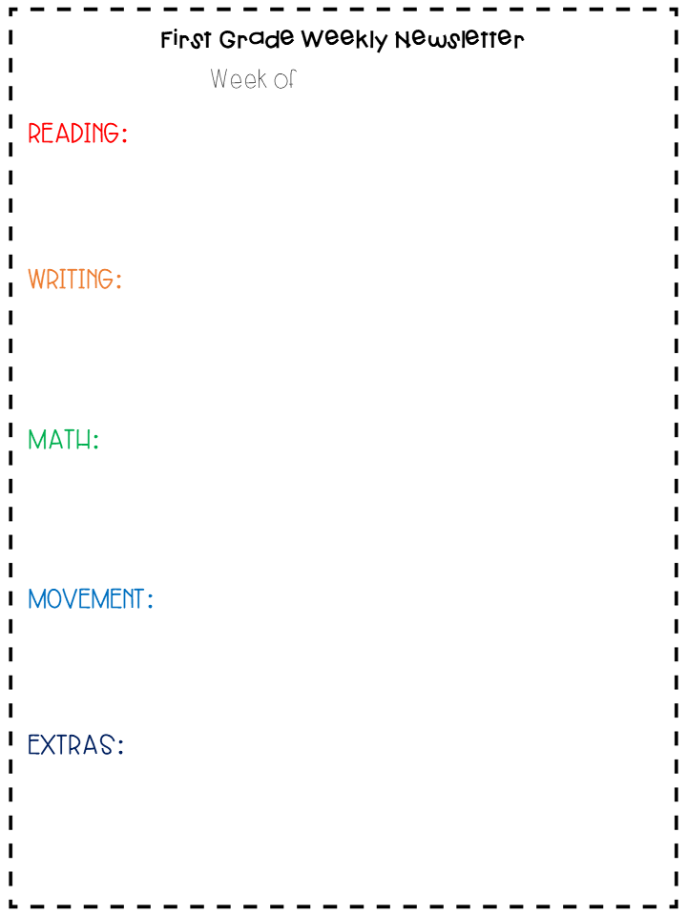
March 16 – 20, 2020
This week we want students to become familiar with online learning tools available to them. Take this time to create accounts on seesaw and epic. Log into iReady and complete one reading lesson.
Get out your spring writing journal. Choose one writing prompt. Remember to use capital letters at the beginnings of your sentences, good spacing, your best spelling and handwriting, and punctuation. If you didn’t pick up a journal, use a notebook from home.
Log into your prodigy account. Log into iReady and complete one math lesson.
Get outside and go for a walk. Stuck inside? Try your favorite GoNoodle activity here or do some yoga here.
Choose a mystery science lesson here.
Learn how to draw a leprechaun puppy here.

