Slide 1


Links for Social-Emotional Learning at Mill Creek Elementary
Cindy Foster
Principal
Mill Creek Elementary
Mary Donnelly
School Counselor
Mill Creek Elementary

Slide 2
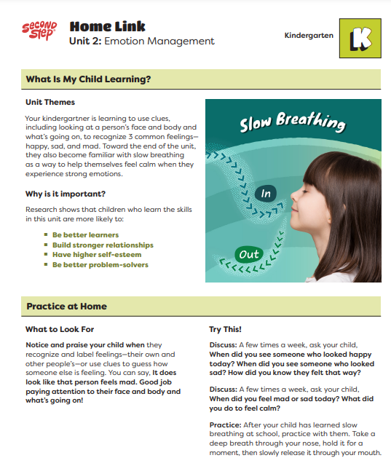
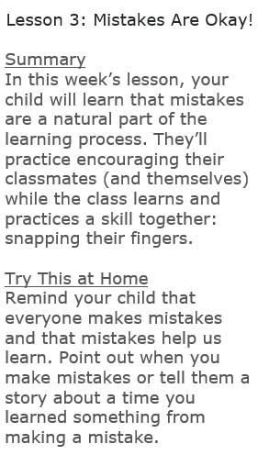
Resources for reinforcing SEL at Home
  Reach out to your child’s teacher to access more social-emotional learning resources, including book lists.
  Watch for Home Links and Weekly Communications from your student’s teacher.
  Join the Second Step® Programs community for Families on their website to learn more about social-emotional learning, why it’s important, and see what your child is learning.
AP21
Second Step® Elementary

Slide 3
Social and Emotional Resources for Families
Mental and Physical Health Resource Links for Families:
Learning Video Resources
SEL Video Resources
Help for Families
Community Resources
SEL resources for families
Crisis Intervention and Counseling Resources
Notes:
Link 1 - There are several video resources available. Resources are available for children and adolescents, including attendance, reading, anxiety, and SAT.
Link 2 - This site offers several video resources better to understand children and adolescents' social and emotional learning.
Link 3 - The third link provides community resources that are available to families for food, housing, and other assistance
Link 4 - This link provides additional available community resources. These resources include where to go for legal assistance, child care, health care, and more.
Link 5 - The fifth link provides resources to help talk to kids about complex issues and to help students regulate emotions.
Link 6 - This link provides resources for crisis interventions and other counseling resources for children and teens.

Slide 4


Helpful Social Emotional Websites
Child Abuse Prevention
Fostering Growth Mindset
Underaged Drinking Prevention
Hot Chocolate Talk
Big Life Journal
Ask Listen Learn
American Psychological Association/RES
Notes:
Big Life Journal provides various growth mindset resources for purchase, free resources, classes for parents, and blogs on different topics.
Hot Chocolate Talk is a resource provided by Committee for Children. The site offers a how-to guide for having safety conversations with your child, so you can empower your child to report and refuse sexual abuse.
Ask, Listen, Learn site guides adults with ways to start communicating with kids about alcohol and the developing brain– and how to continue talking to them as part of a lifetime of conversations.
RESilence, through the American Psychological Association, is a site that provides information for uplifting youth through healthy communication about race.

Slide 5
Questions?
Cindy Foster
Principal
cfoster@everettsd.org
425-385-6800
Mary Donnelly
School Counselor
mdonnelly@everettsd.org
425-385-6810

